Slide 1
Impact of Solving Our “Challenges”
Overview of the continental landscape past 10 years

Slide 2
“Challenges” has been one of the most common words in AfPIF talks and discussions past 10 years
Are we still talking about the same challenges as 10 years ago?
Did solving those challenges introduce new challenges?

Slide 3
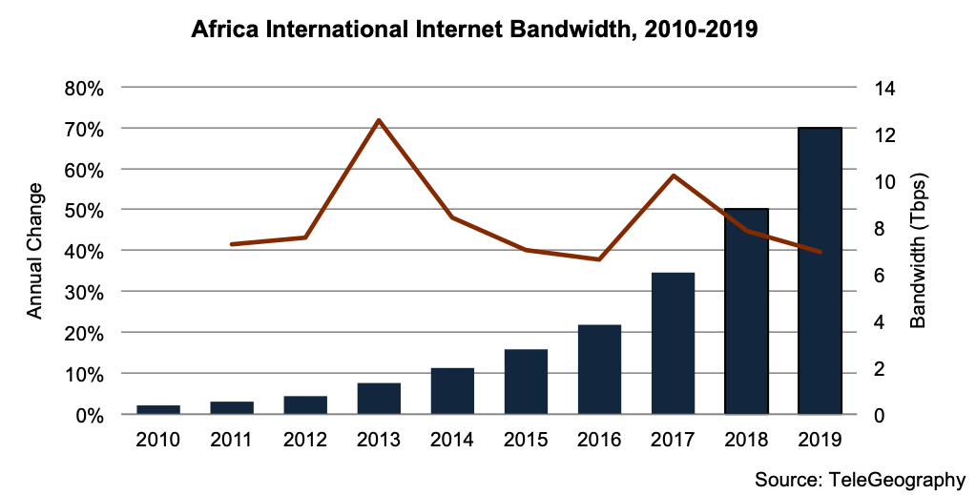
Growth of int’l internet bw to Africa

Slide 4
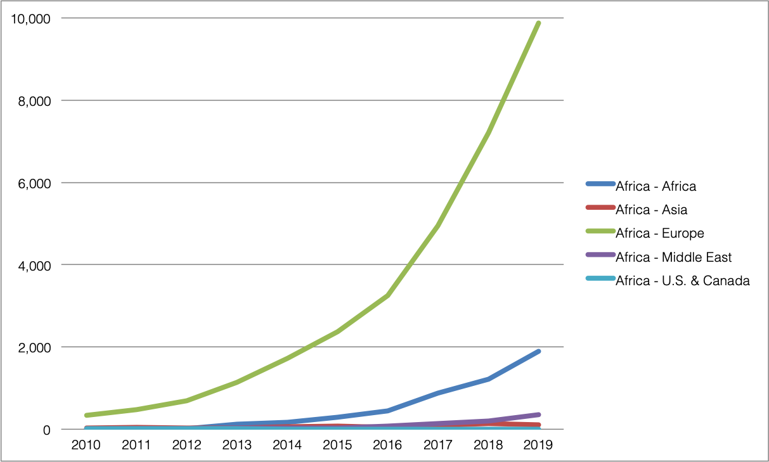
Int’l internet bw growth to Africa by region

Slide 5
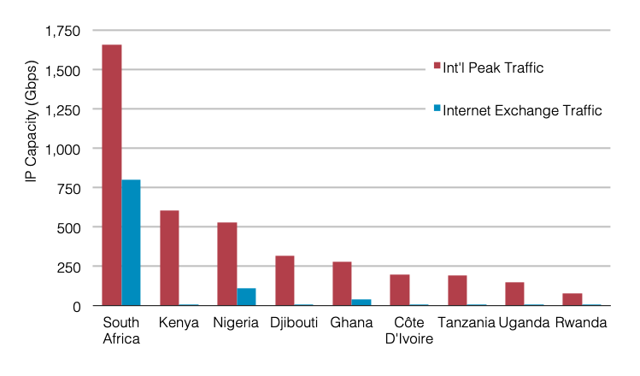
Growth of int’l internet bw to Africa
Notes:
\

Slide 6
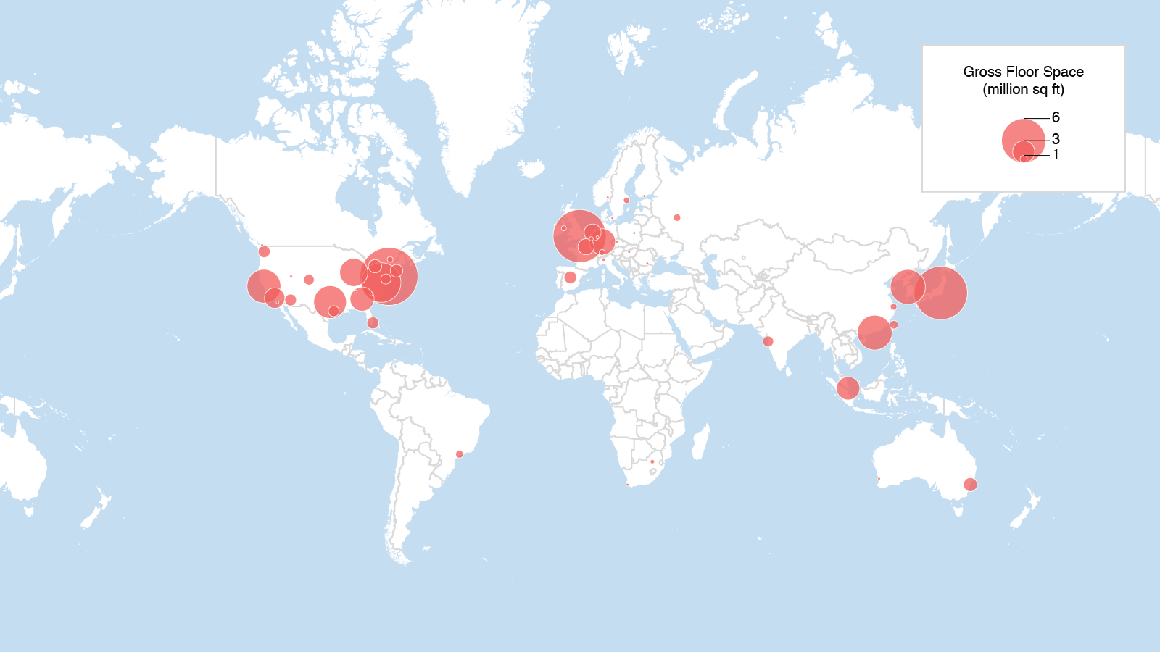
Where networks converge
Colocation Floor Space, 2019
Carlsbad, CA | Washington, DC | Exeter, UK | Singapore | www.telegeography.com | info@telegeography.com

Slide 7
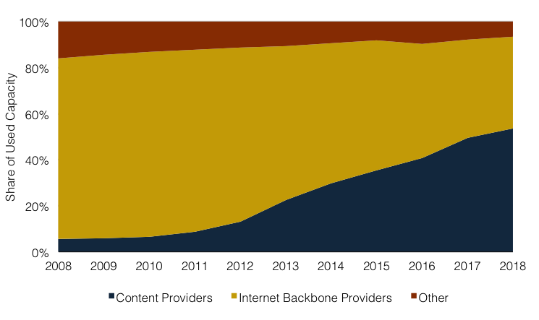
Surge of content provider bandwidth
Used International Bandwidth by Source
Internet backbone providers’ dominance has diminished since 2010
Content providers (including Google, Facebook, Microsoft, Amazon) accounted for 54 percent globally in 2018

Slide 8
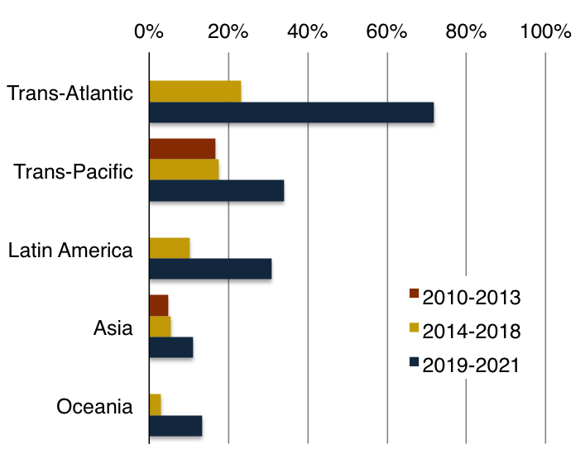
Content provider investment
Content providers’ share surging on many routes
But only a majority on the Atlantic
Substantial investment by new carriers’ carriers:
Aqua Comms, Hawaiki, RTI, Seaborn Networks, PLDC
Additional investment on new routes is planned
Content Provider Share of Investment in New Submarine Cables
Notes:
Although content providers are driving demand and make half of used bandwidth, carriers still have other half… and there is substantial investion my carriers carriers
Investment sustained in established markets, increasing in emerging
Although content provider share is surging on many routes, only a majority on the trans-atlantic

Slide 9
The internet is a combination of complex relationships between various players
Lets look at what these key players have done and what is planned in the near future
What the impact might be and whether these developments will solve our challenges or give us new ones

Slide 10
Thank You!
Questions?
pchristian@telegeography.com

