Slide 1
RWANDA THE NEXT DESTINATION
WELCOME TO RWANDA
The African Peering and Interconnection Forum 2020
On behalf of my country Rwanda and RICTA, we are honored and privileged to be the host for a such Implausible event of Africa Peering and Interconnection Forum year 2020.
You are most welcome to the “HEART OF AFRICA”

Slide 2
RWANDA AT GLANCE
Rwanda is a country in Central and East Africa with the population of 13M. She is known as the land of a thousand hills!
Rwanda’s stunning scenery and warm, friendly people offer unique experiences in one of the more remarkable countries in the world.
For the past 25 years, Rwanda has been transformed into one of the Continent’s most attractive economies, displaying a remarkable record of political stability, sustainable growth and economic diversity.

Slide 3
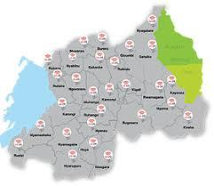
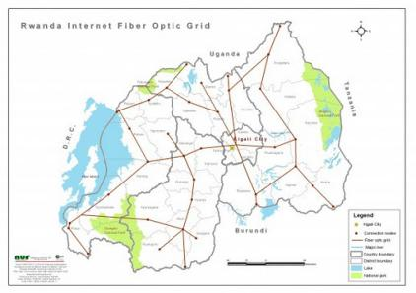
INDUSTRY DEVELOPMENT
Internet and ICT in general has been given the highest
priority on the govt’s agenda
96.6% of the country is covered with 4G LTE

Slide 4
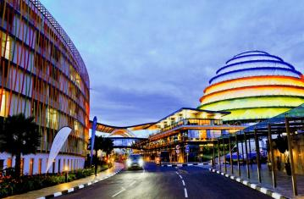
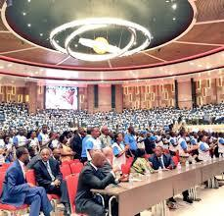
MEETINGS , INCENTIVES, CONFERENCES AND
EXHIBITIONS (MICE)
Meetings, Incentives, Conferences and Exhibitions industry is growing rapidly
The quality of Accommodation is world renowned and constantly improving
Visitors can rest assured the country is safe as well as stunning – Rwanda
was ranked the 9th safest country in the world by the World Economic Forum.

Slide 5
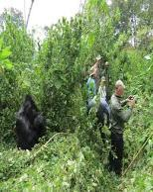
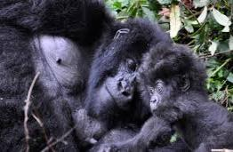
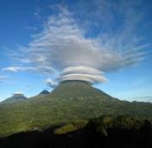
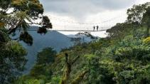
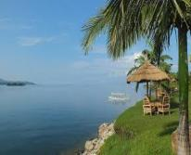
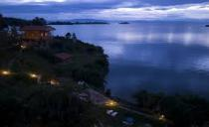
THE BEAUTY OF RWANDA
For those who may plan to adventure the beauty of the country
After or before the conference, you can visit the Volcanoes,
Mountain gorillas, birds and very many others.
The country is also home to chimpanzees as well host of monkeys

Slide 6
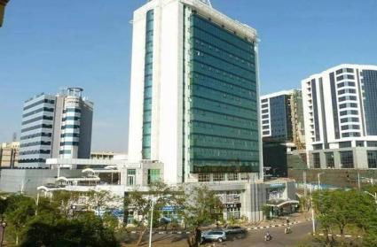
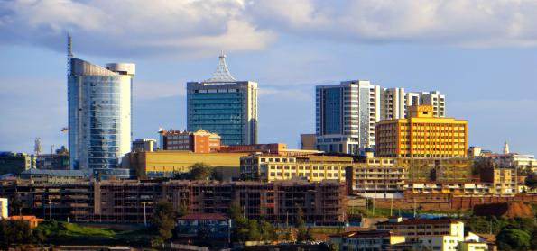
INVESTMENT OPPORTUNITIES IN RWANDA
Rwanda has an array of incentives for investors ready to invest
in the country, in a wide range of sectors.
Starting a business in Rwanda is quick and easy, with a
streamlined process.
Tea and coffee are now one of the country’s largest exports.

Slide 7
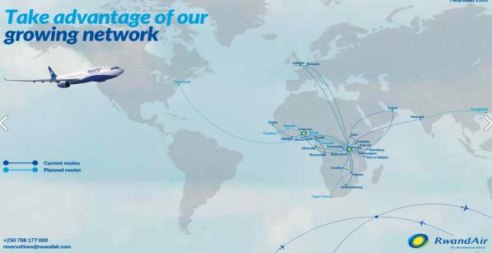
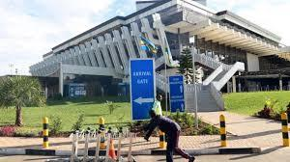
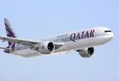
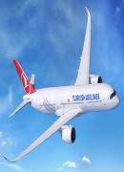
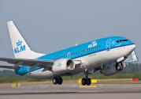
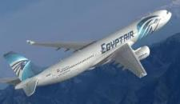
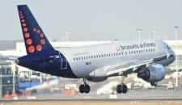
RWANDA’S ACCESSIBILITY
With RwandAir connecting to different destinations, other airlines like KQ,
KLM, Ethiopian Airlines, Brussels Airlines, Egypt Air and Turkish Airlines.
VISA on arrival for all nationals from all countries.

Slide 8
THANK YOU
MERCI
ASANTE
MURAKOZE

