Slide 1
The Road to AfPIF 10

Slide 2
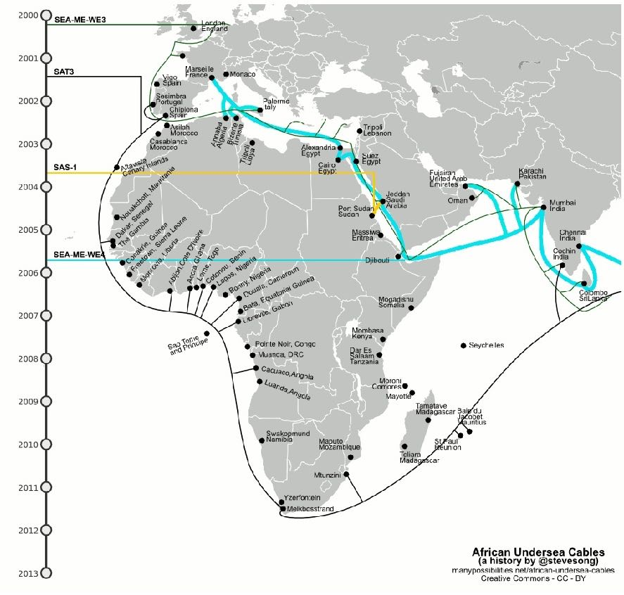
Internet in Africa circa 2007/2008
Only 5.3% of Africans with Internet connection (2008)
But 1000%+ annual growth rate
Satellite connections predominant, cost $3,000 - $5,000 per Mbps
SAT3/SAFE cable, some report paying $4,500 - $12,000 per Mbps
An “Island Continent”
Only ~400,000km of of terrestrial transmission network operational or planned
Limited cross border interconnectivity
Policy dialogue focused on imposing telecom-style accounting rate system to the Internet.
African subsea cable infrastructure 2008 (via Steve Song)
Notes:
Note NEPAD Efforts.
Note Seacom.
Things were starting to move… but they were in pieces.
A lot of discussion outside of Africa.
“Revenue apportionment”

Slide 3
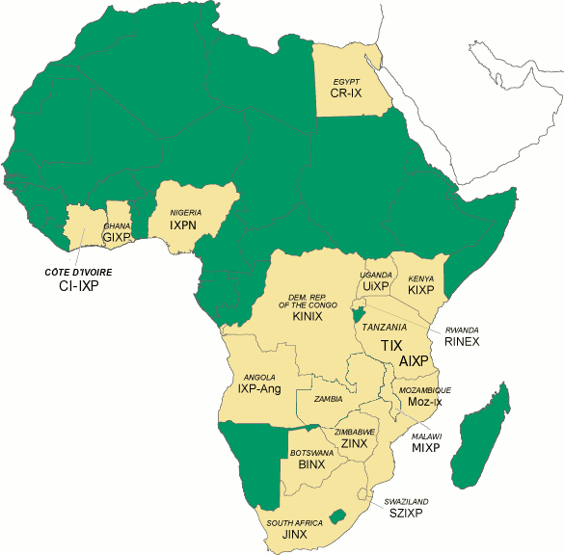
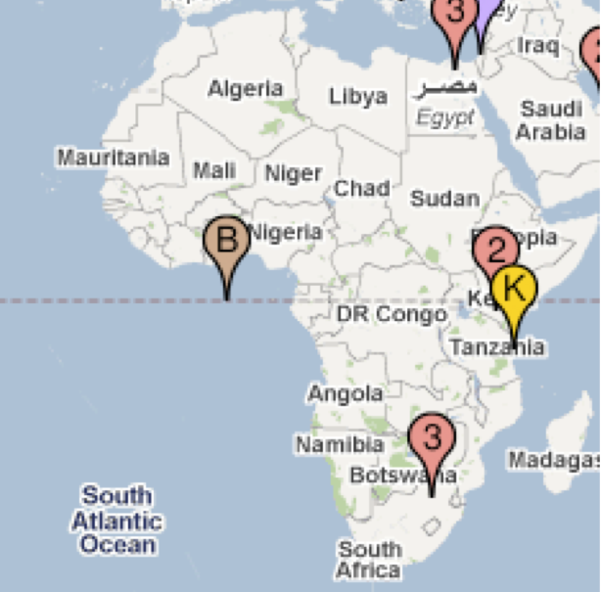
Pre-PIF & Proto-PIF
The economic & performance leverage point: Interconnection and traffic exchange
Initial focus on creating an IXP association (07/08)
20+ IXPs in Africa “on paper”
Couldn’t find managers
Development projects gone fallow
Little growth and few networks participating
2008 INET @ AfNOG: “African Interconnection – the Value Proposition”
Right mix, right time
African IXP map circa 2008 (via NSRC)
http//:Root-servers.org - (~2009)

Slide 4
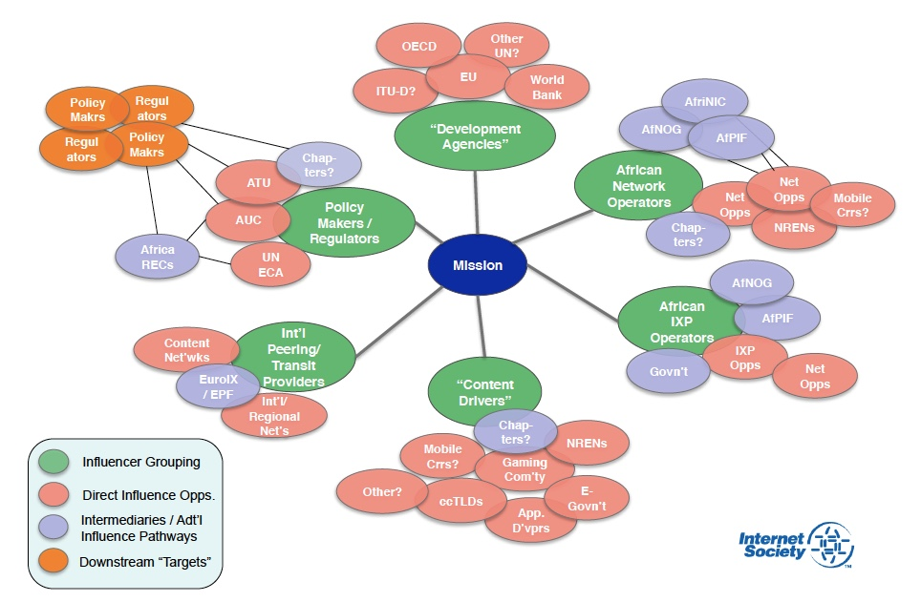
Taking a Systems Approach to Interconnection in Africa
A multitude of efforts with partners aimed at priming the pump:
Local workshops & capacity building
Supporting new IX development
Supporting existing IXPs and adding value
Advocating in regional & international policy forums
Engaging development & funding organizations
Measurement & research
AfPIF: The community glue to sustain and build momentum
Project Chart Circa 2011
Notes:
SOMETHING HERE ABOUT GROWING traffic exchanged & 80/20 by 2020.
Exit in 10 years.
Text here on focusing On different parts of the ecosystem – including policymakers and content Networks (OECD/WB/ADB/UNECA)
Note public and private work includiing NEPAD Afpif part of a larger project on ITE including workshops IX development assistance etc.
Also needed to avoid problems with IX projects done in the early 2000’s that were not sustainable

Slide 5
The Killer: Information Asymmetry
in-fər-ˈmā-shən (ˌ)ā-ˈsi-mə-trē
“…occurs when one party to an economic transaction possesses greater material knowledge than the other party.”
Key Problem: “I manage my network and buy the Internet.”
Key Requirement : Increase knowledge & relationships necessary to:
Negotiate better deals
Create peering opportunities
Create & sustain local and regional traffic exchange
Catalyze growth
Attract new services

Slide 6
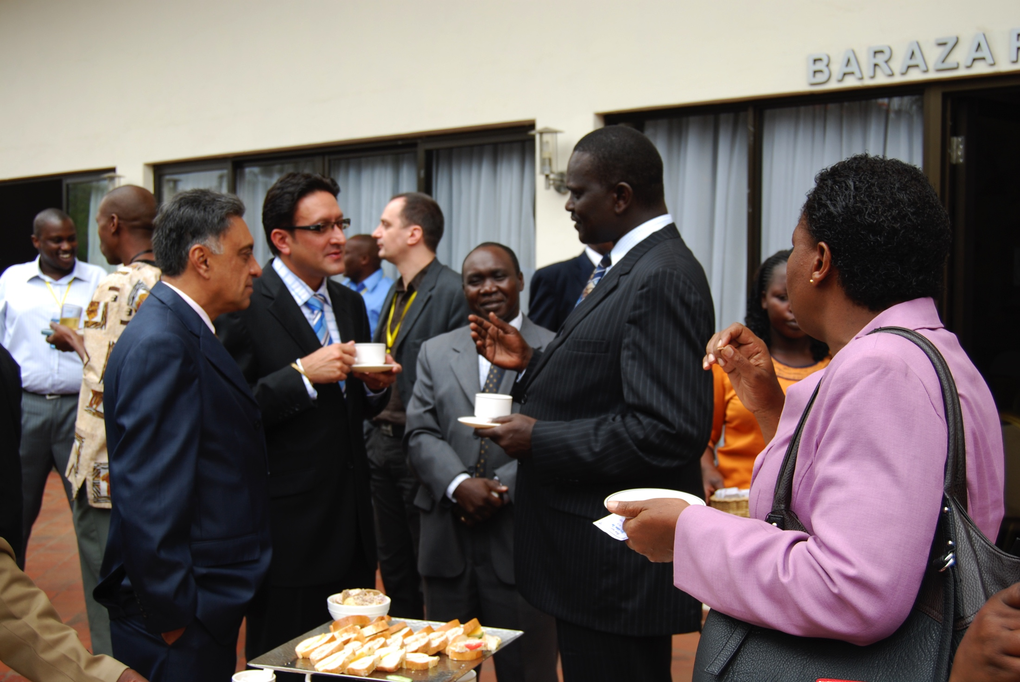
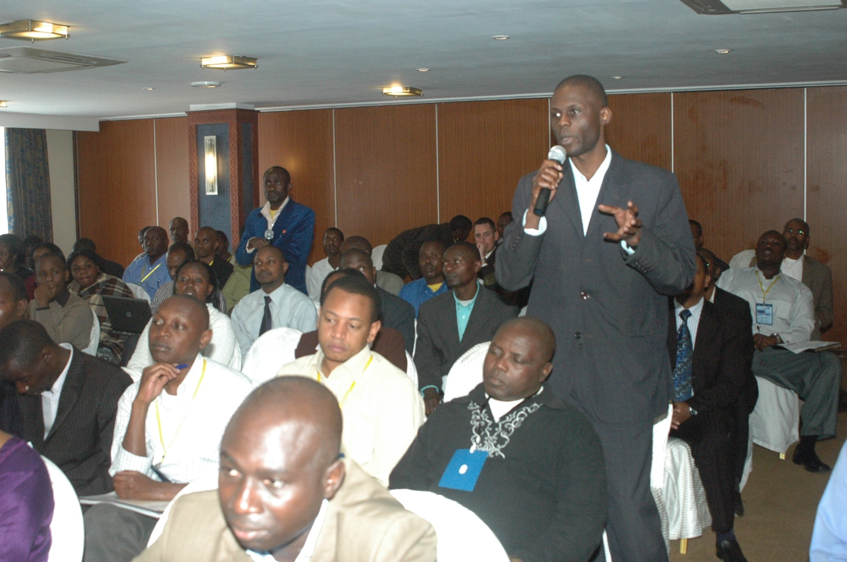
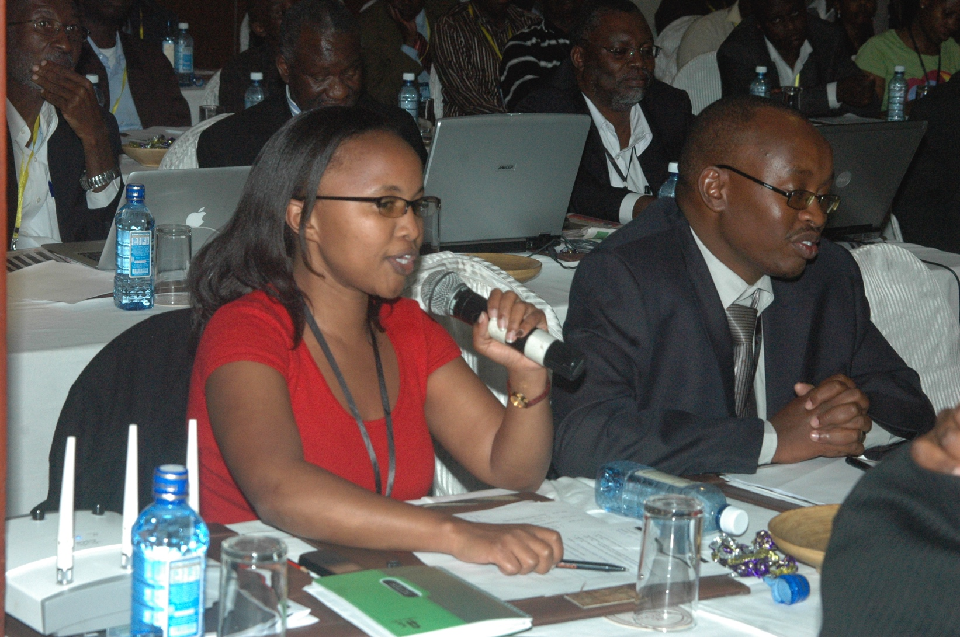
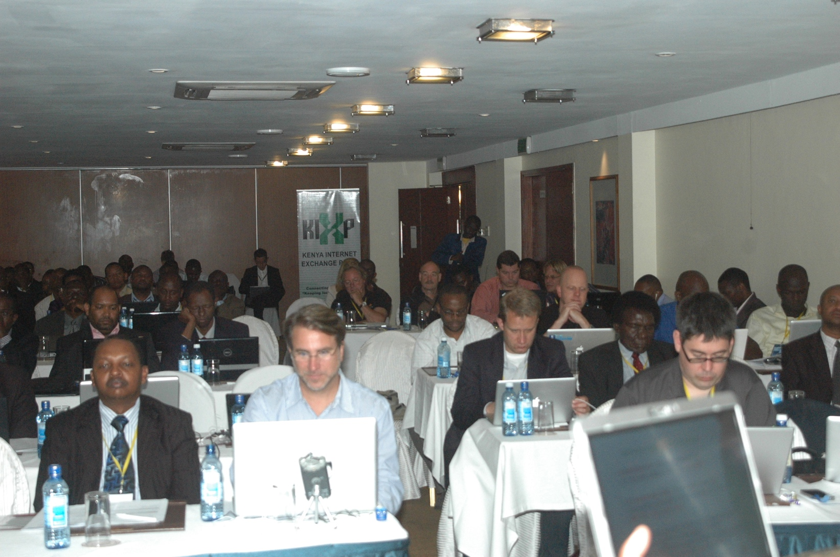
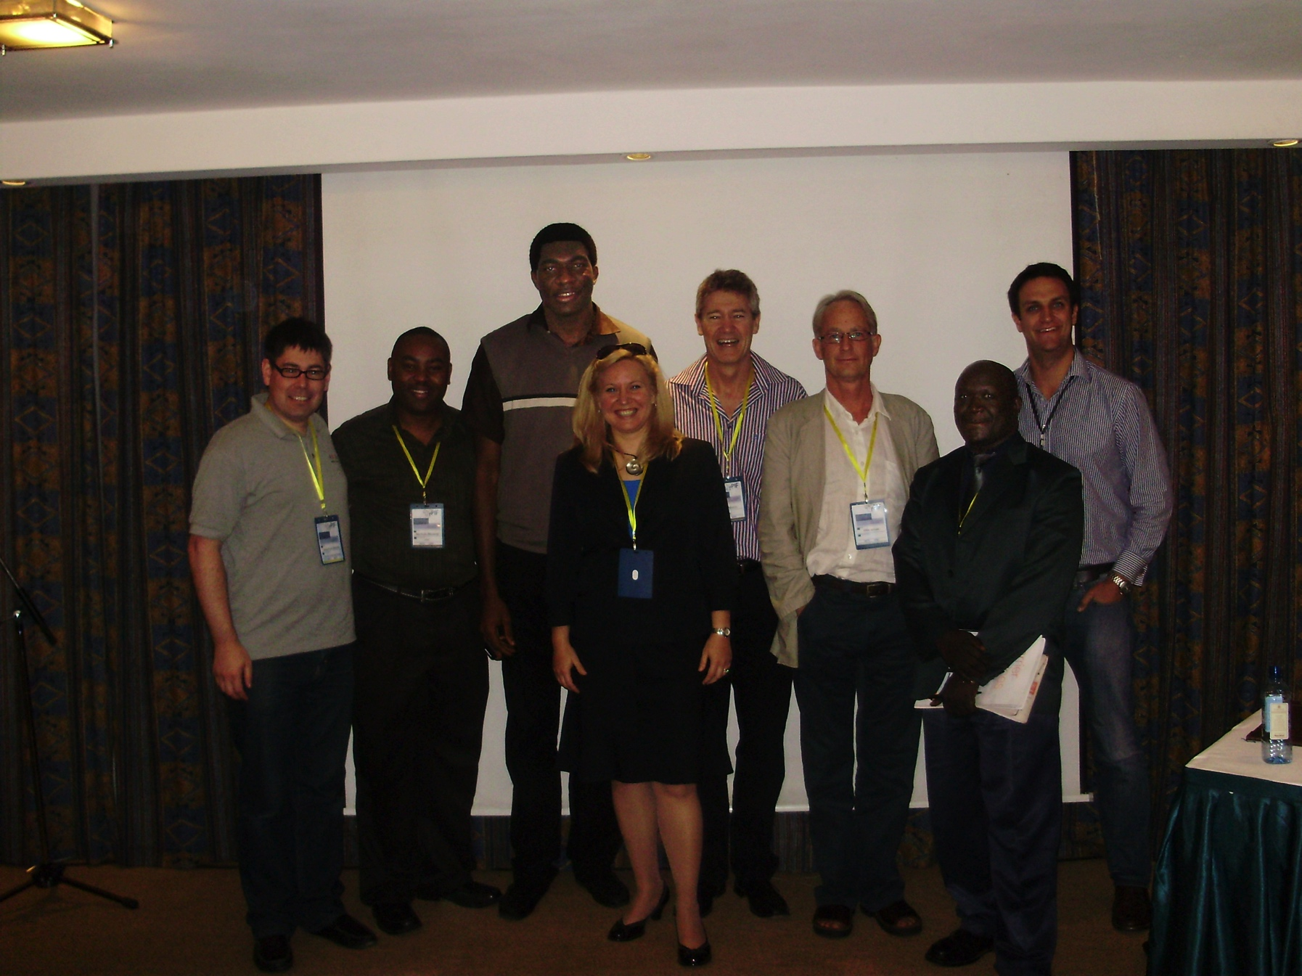
AfPIF-1: 2010 Nairobi, Kenya
2 Days, ~80 Attendees
20 African countries + int. participants
Local Host:
Sponsors:

Slide 7
Beyond AfPIF

Slide 8
Collaborators – Thank you!

Slide 9
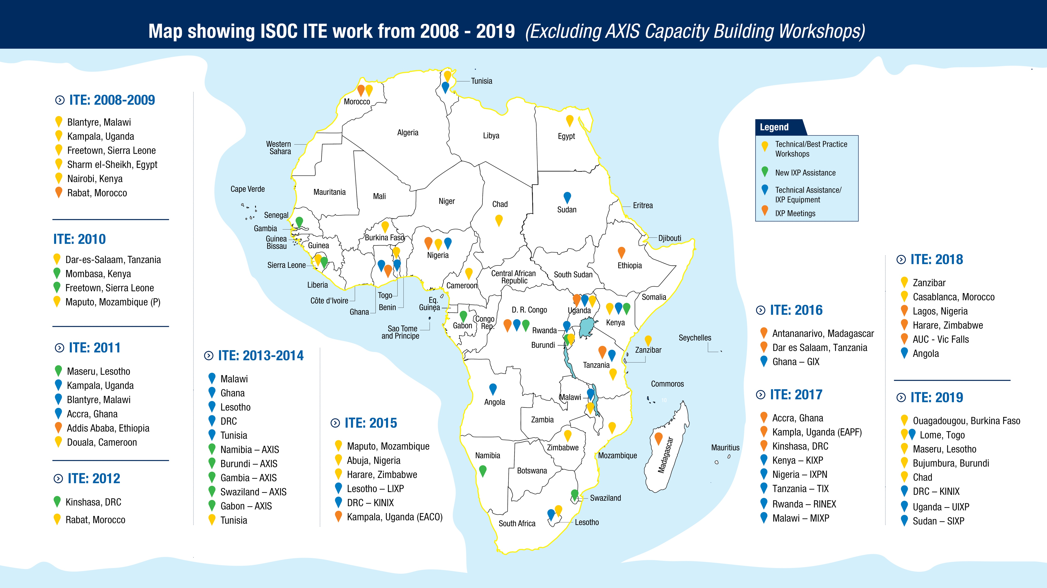

Slide 10
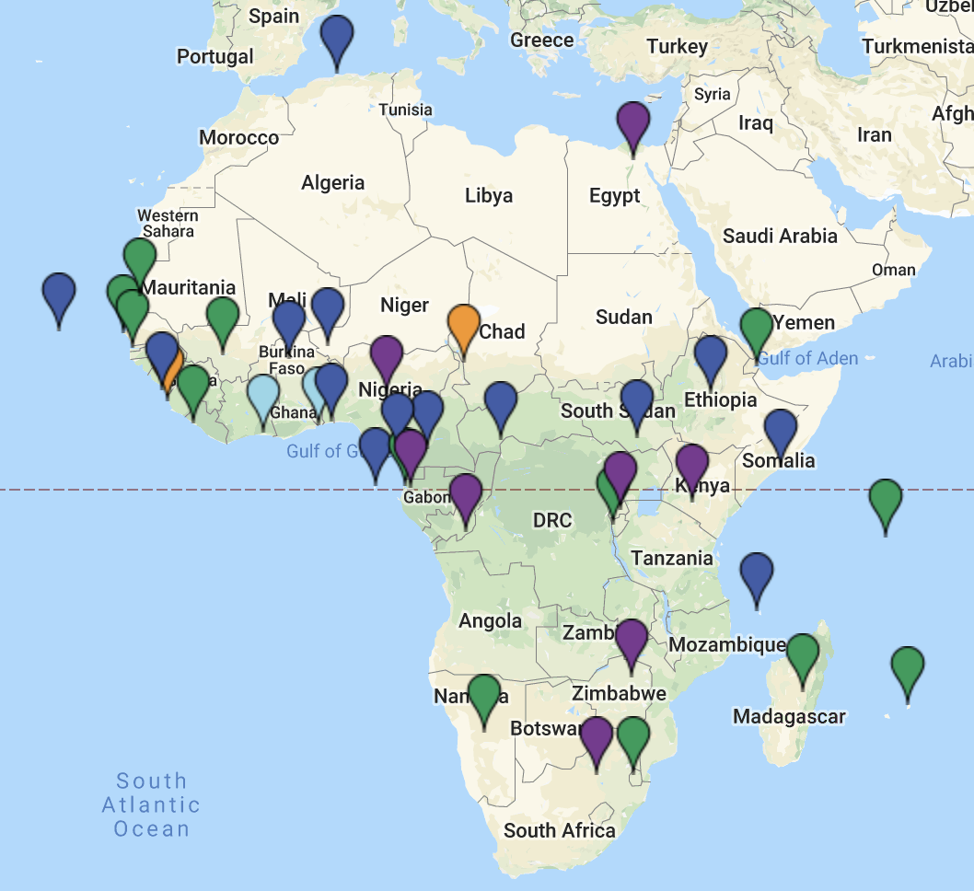
African Union AXIS Project
Summary of AXIS Project:
From 2012 - 2018
New partnership with the African Union
Trained over 1500 people in 28 Countries
Creation of at least 10 New IXPs
Support of 8 IXPs to grow into Regional IXPs
Increased awareness on the value of IXPs
Policy work on cross-border interconnection
Source: https://au.int/en/axis

Slide 11
Key Value Builders

Slide 12
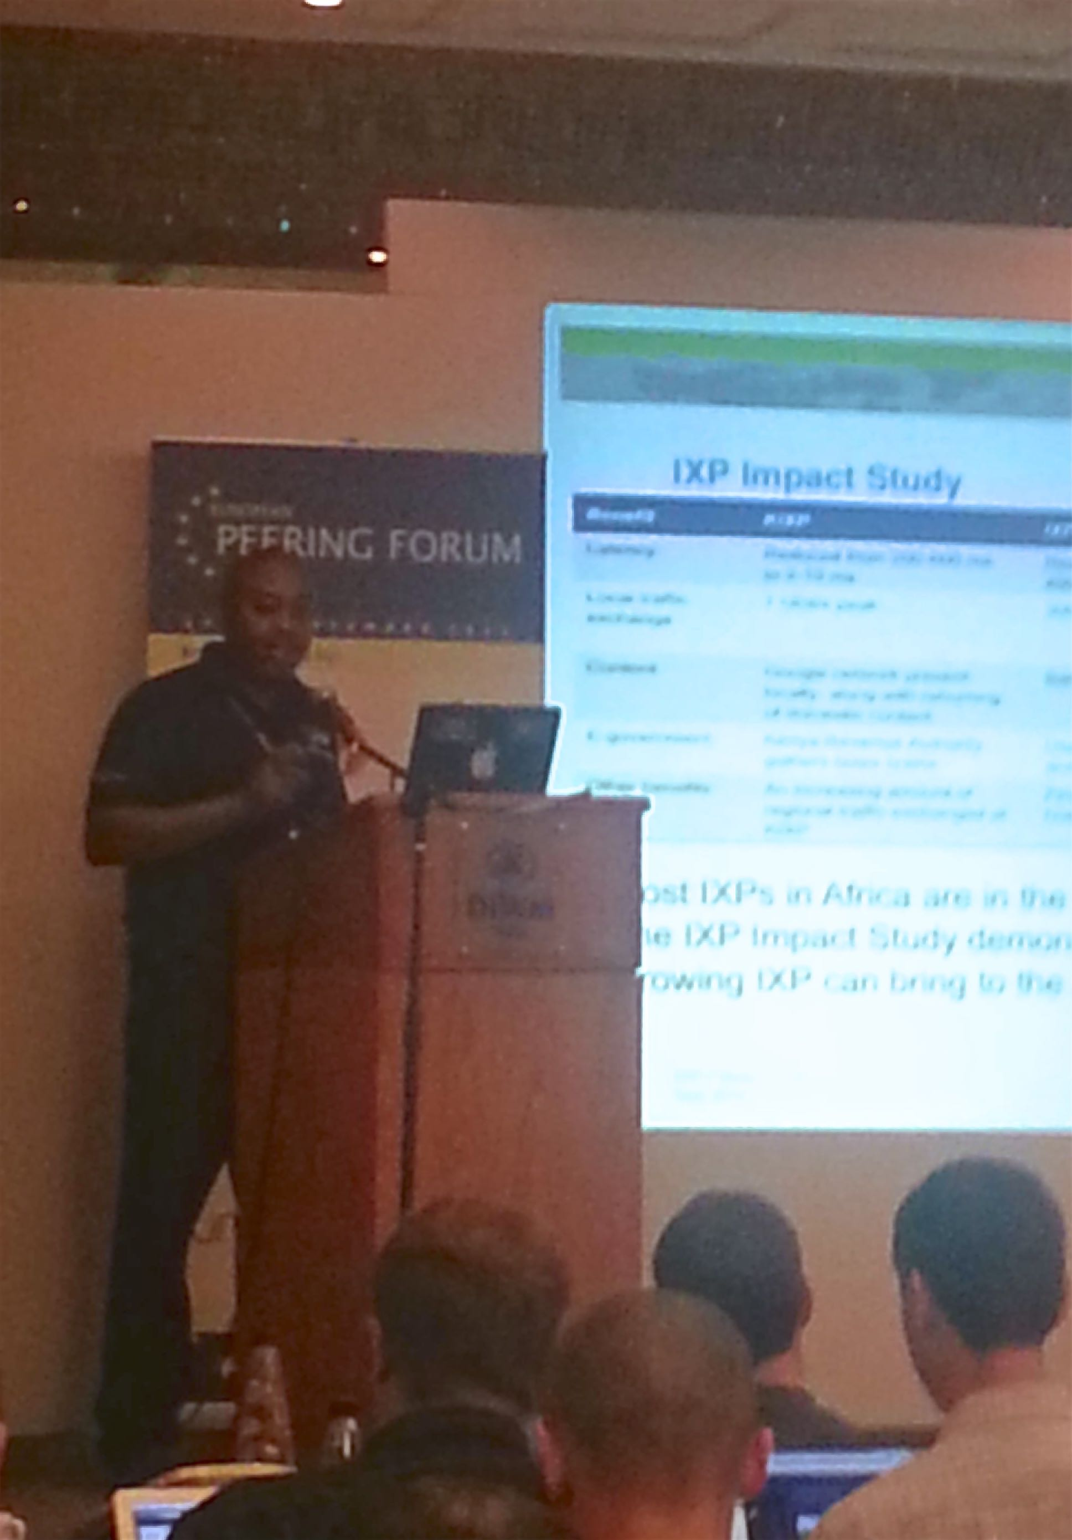
Content & the Globe Come to AfPIF
Africa had the fastest growing Internet market but…
…many global providers had limited understanding of the market, and…
…nearly all content was hosted outside Africa, with few local caches.
Big push in early years to explain the African market and bring content & global providers to AfPIF
EPF 5 and 7 critical
Mutual opportunity!
Thanks!
Notes:
Africa Networks attending EPF events today
Building the community… together.
Catalyzing untapped business potential
Between African companies and between Africa and the rest of the world
Explore further how to realize more -- First 10 years was about opening up the space, what more can be done
While we’ve come far -- the progress hasn’t been even. At 10 years we need to think about how we can turn and get to those places that haven't yet gotten on the bus.

Slide 13
Learning & Networking @ AfPIF
The Peering Game @ AfPIF
Over 600 peering books distributed
Peering book translated to French
Peering Personals
Peering Meeting tool
Notes:
Building the community… together.
Catalyzing untapped business potential
Between African companies and between Africa and the rest of the world
Explore further how to realize more -- First 10 years was about opening up the space, what more can be done
While we’ve come far -- the progress hasn’t been even. At 10 years we need to think about how we can turn and get to those places that haven't yet gotten on the bus.

Slide 14
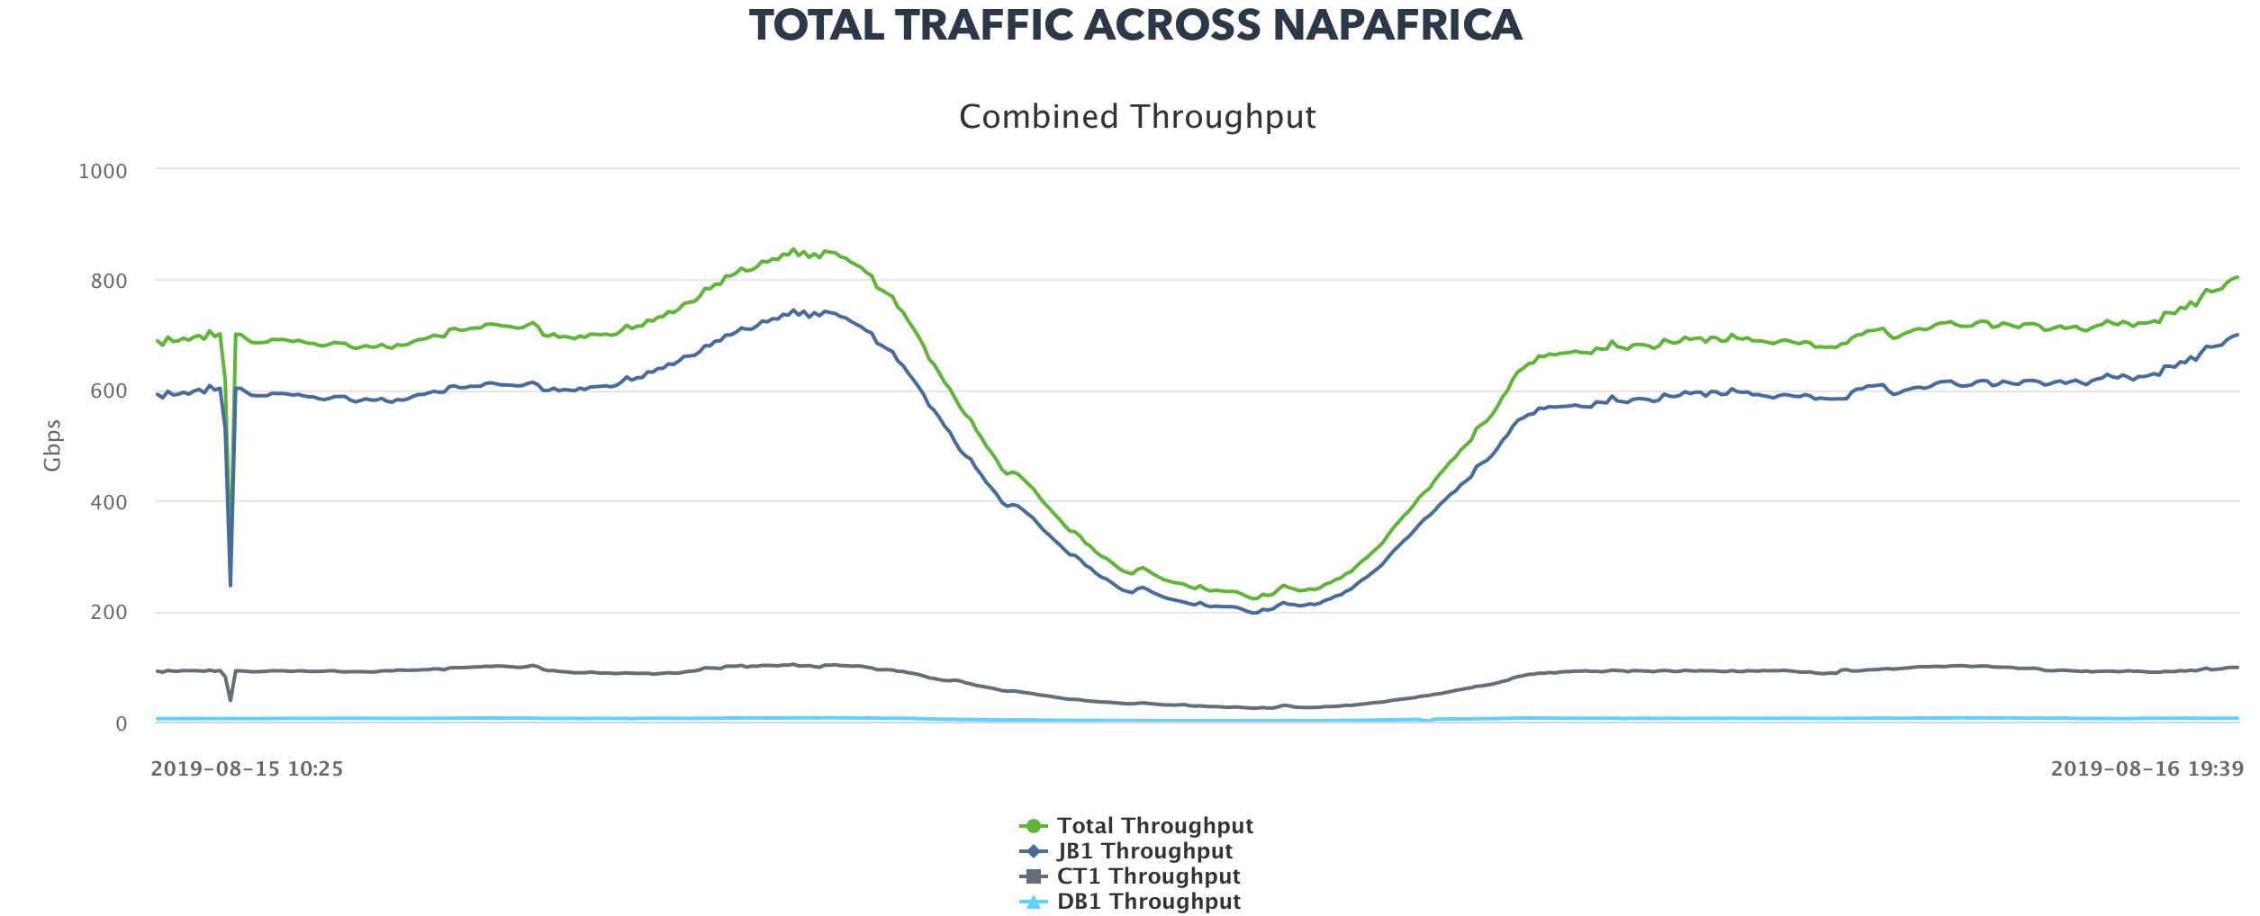
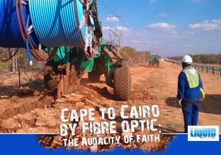
Vision and Goals
Keep focused on the horizon!
Why - An Africa that creates & not just a consumes the Internet
How – A self-sustainable community of practice within 10 years.
What – Community ownership and buy-in
“80/20 by 2020”

Slide 15
Infrastructure Development

Slide 16
IXP Infrastructure
45 IXPs located in 41 cities in 33 countries
Over 1000 Networks connected
More networks connected using fiber
More IXPs in West, Central Africa and Indian Ocean Islands
Source: https://www.af-ix.net

Slide 17
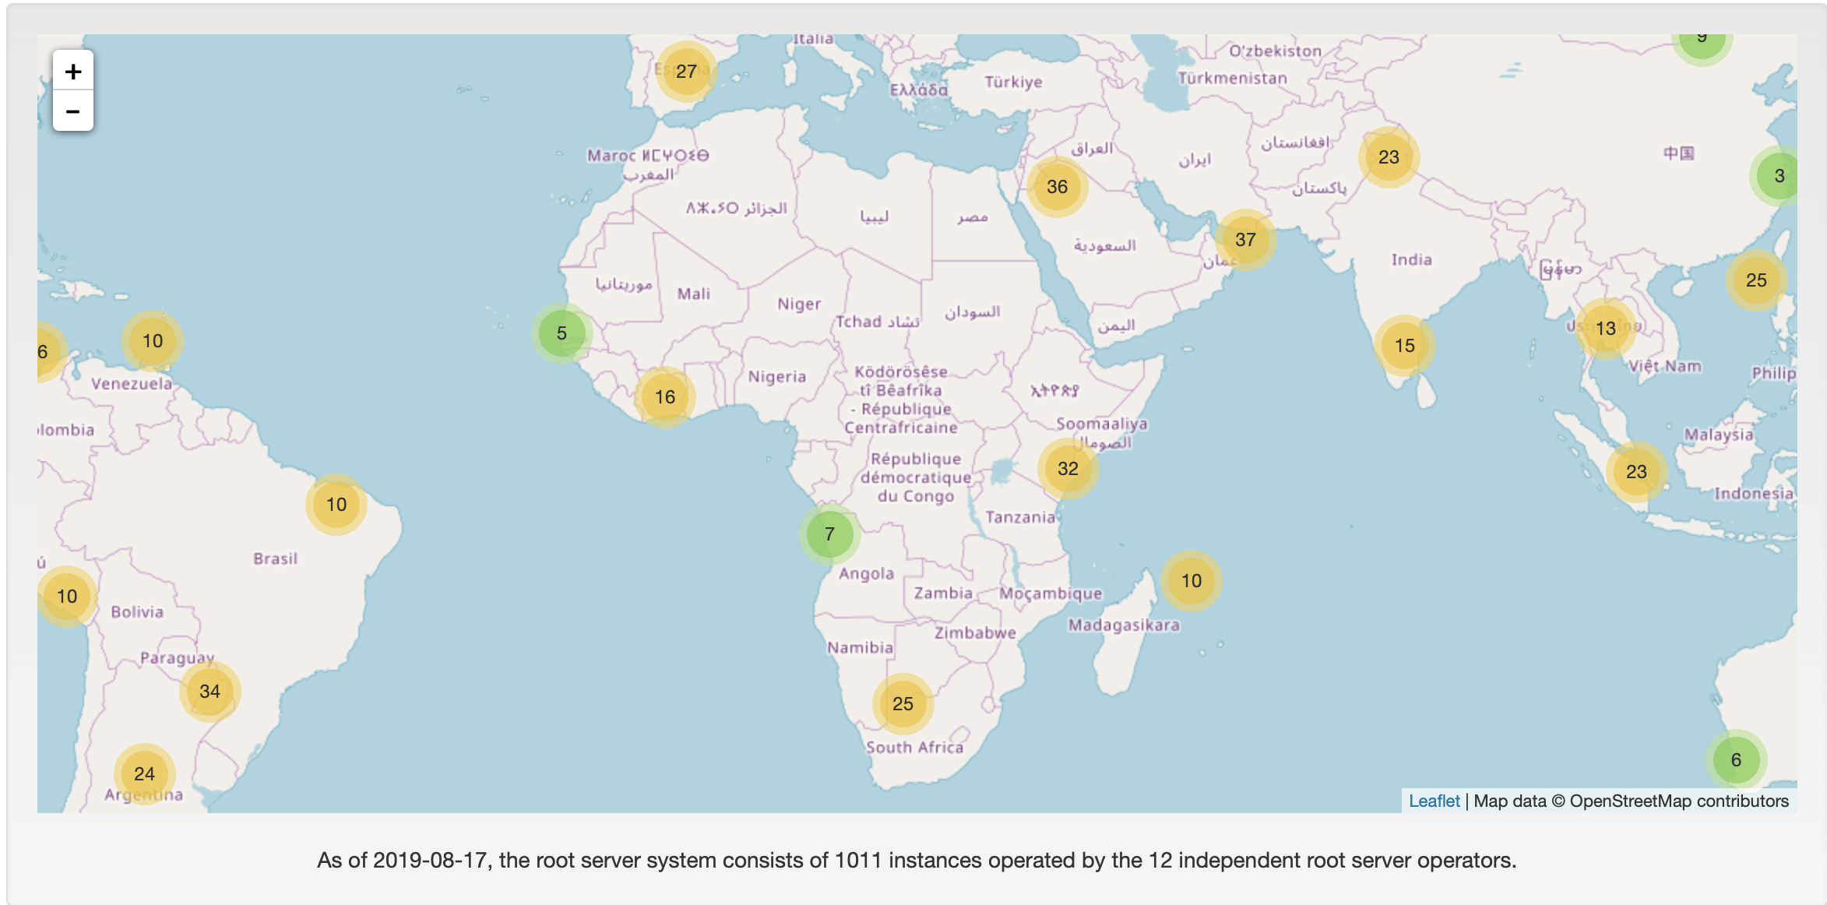
DNS Infrastructure
Source: https://root-servers.org

Slide 18
Africa Data Centre Market
Africa’s Top 5 DC markets (based on number of MTDCs):
South Africa
Nigeria
Egypt
Morocco
Kenya
30% of Africa’s DCs are in South Africa
20% of MTDCs are in West Africa
15% of MTDCs are in North Africa
30% of African countries do not have dedicated, commercial colocation facilities
Approx.. 55% of DC space is in South Africa
Source: Teraco Data Environments

Slide 19
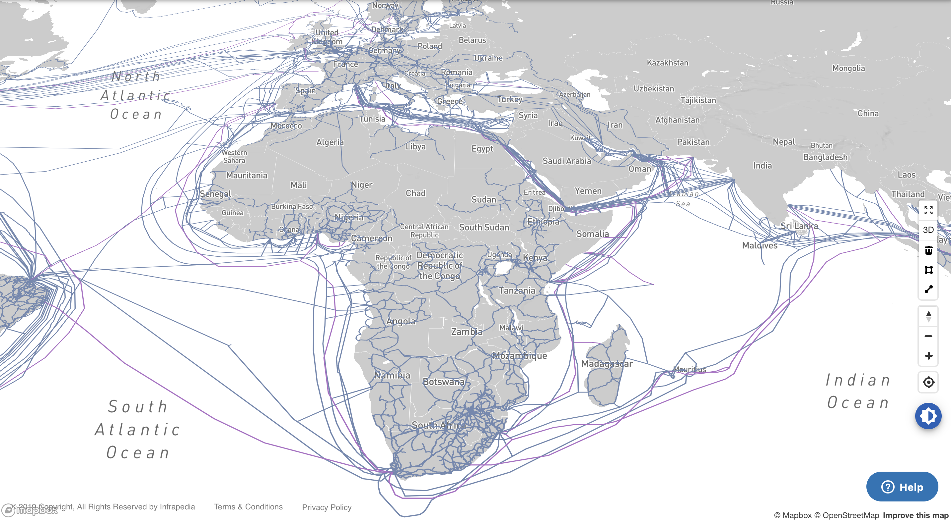
Submarine and Terrestrial Infrastructure
Source: https://live.infrapedia.com/

Slide 20
Where are we?

Slide 21
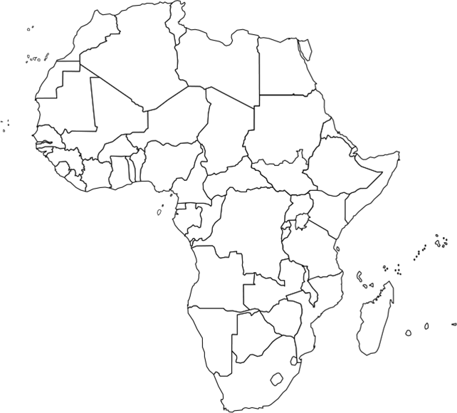
AfPIF @ 10: Meeting from Cape Town to Casablanca
Nairobi, Kenya | 2010
Accra, Ghana | 2011
Johannesburg, South Africa | 2012
Casablanca, Morocco | 2013
Dakar, Senegal | 2014
Maputo, Mozambique | 2015
Dar es Salaam, Tanzania | 2016
Abidjan, Ivory Coast | 2017
Cape Town, South Africa | 2018
Balaclava, Mauritius | 2019

Slide 22
Program Committee (PC)
PC is drawn from peering community
There are two co-chairs
Inaugural PC established in 2016 with 3 year term – 12 Members
Second PC commenced in 2019 – 12 Members (5 new)
PC charter

Slide 23
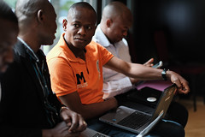
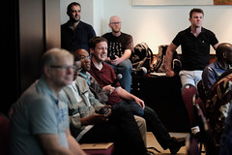
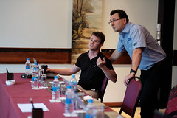
Established (informally) in 2012
Annual meetings
Secretariat established in 2019
Co-organizers of AfPIF
Key to the future of peering Africa
Notes:
- Key to IXP self-determination in Africa

Slide 24
Attendance & Fellowships
Women In Tech Fellowship Program
Notes:
Originally was designed for IXPs in exchange for inviting and bringing a peering network to AfPIF
Some IXPs managed to convince operators such as Angola IXP – who at one time brought over 2 peers
Now focuses on those qualifying and not able to attend
Introduction of WomenInTech fellowship in 2018 and 2019 – gives an opportunity to women who qualify to attend AfPIF but are less likely to get the travel opportunity and also bridges the gender gap

Slide 25
Sponsors

Slide 26
Impact Beyond AfPIF

Slide 27
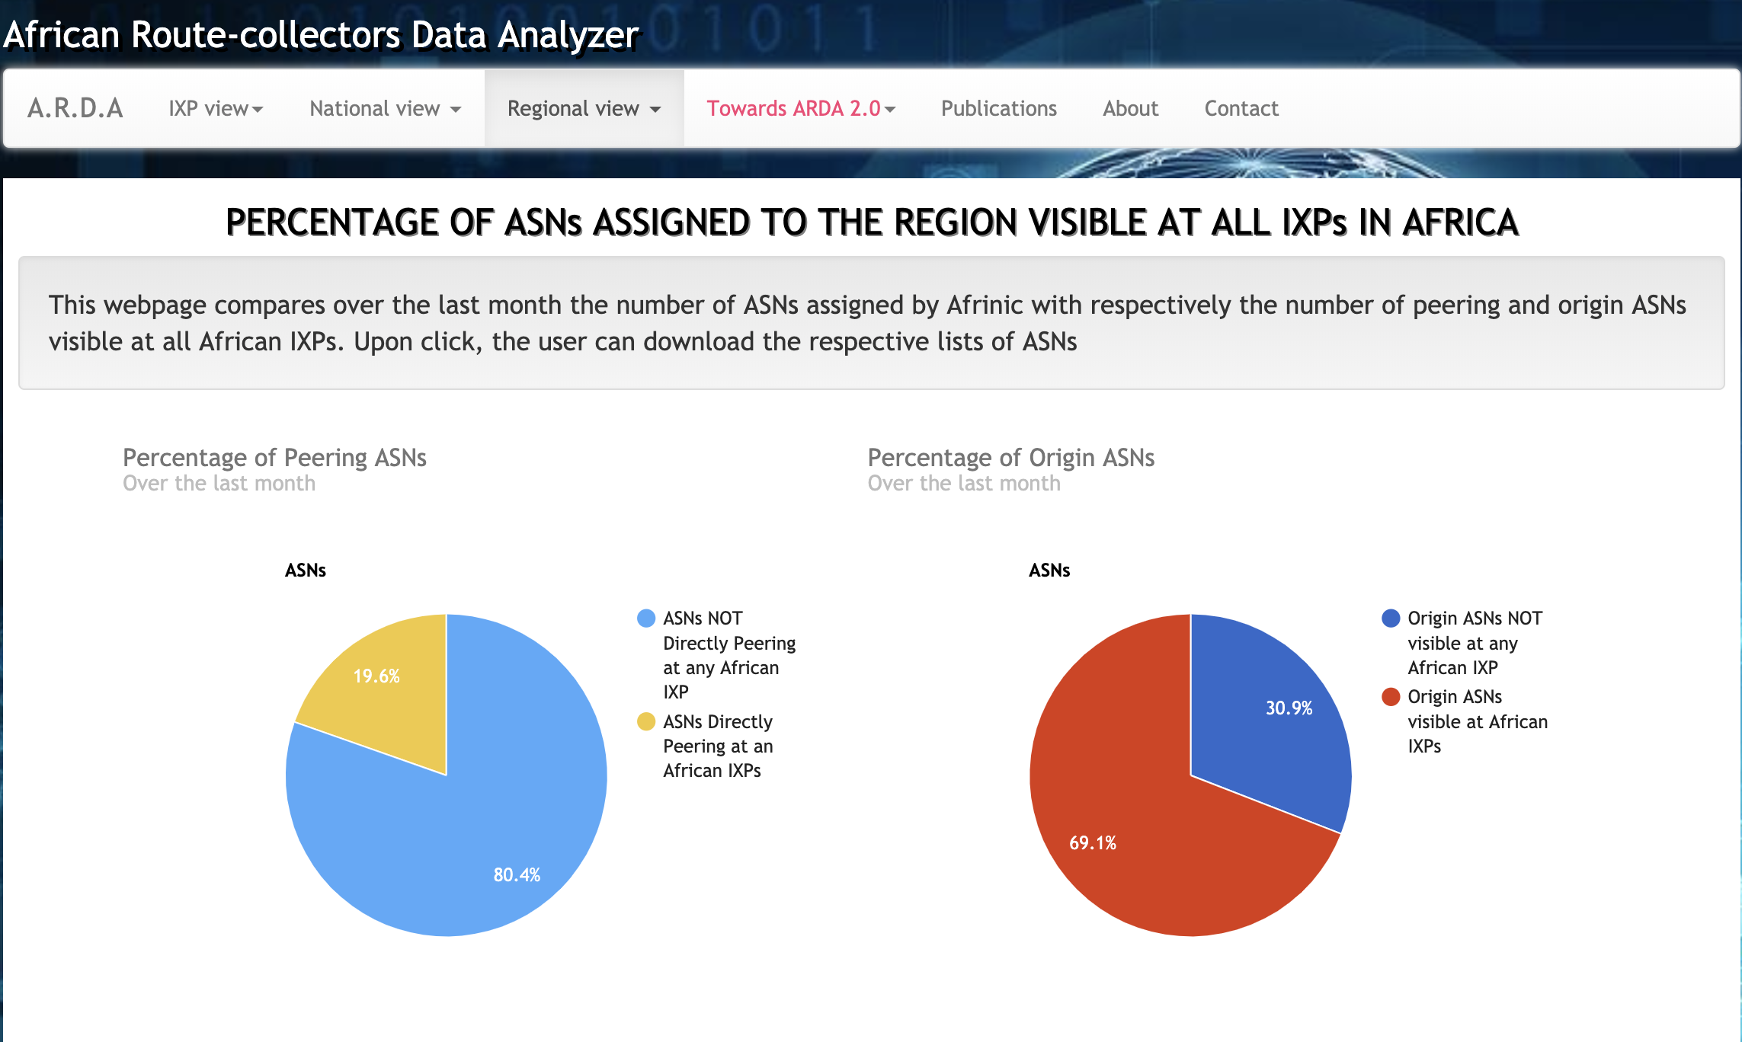
More peering at IXPs in Africa

Slide 28
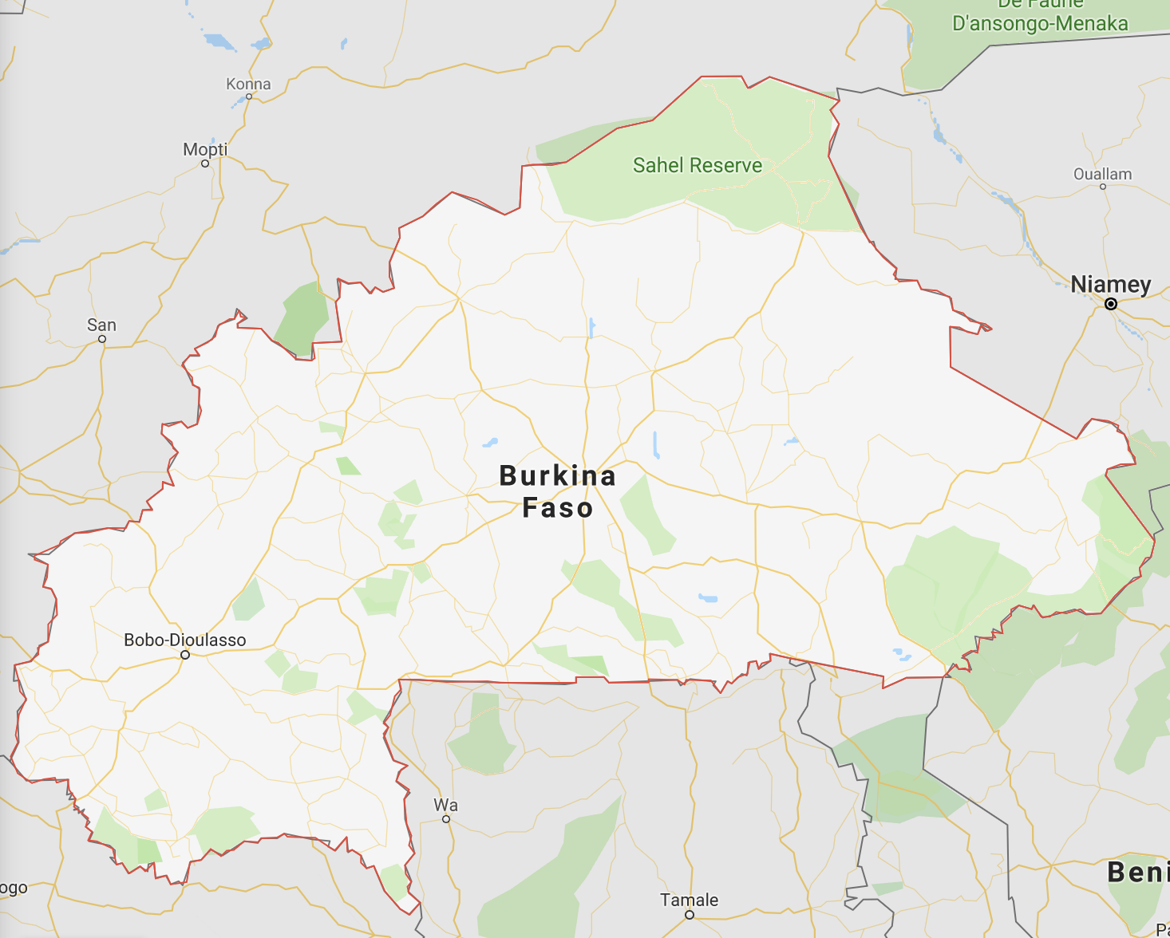
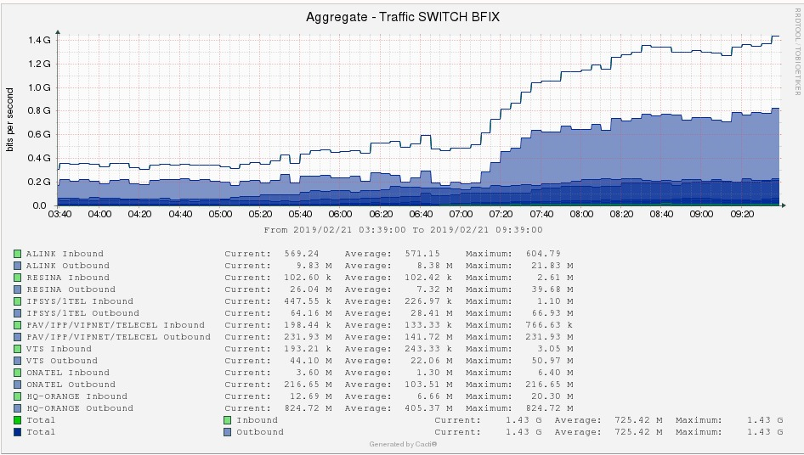
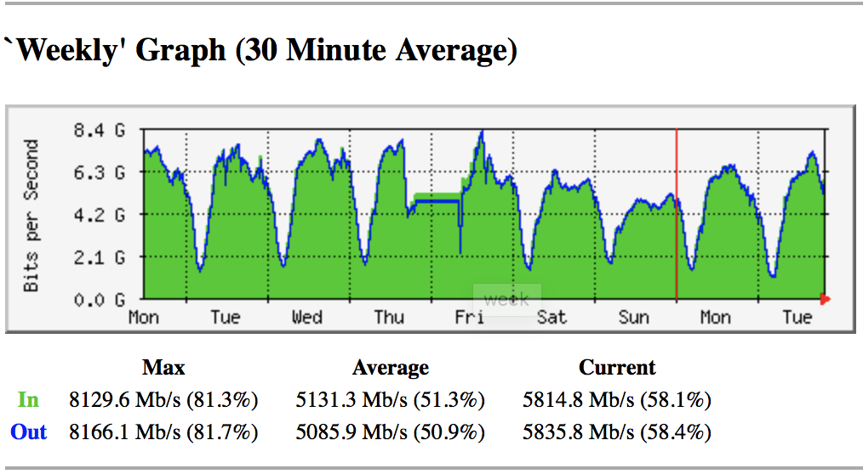
Growing impact of local IXPs
After the peering roadshow and technical workshop;
Community was able to transition from layer 3 to layer 2 IXP in February 2019
Topology change unlocked penned up traffic from 400 to 1.4Gbps
Peak traffic is at currently at about 7Gbps
Saves operators over $120,000 USD per month
We have received requests from BFIX on support for;
New 10Gbps switch to meet growing demand
Notes:
The Kenya and Nigeria IXP Study
Burkina Faso experience in 2019

Slide 29
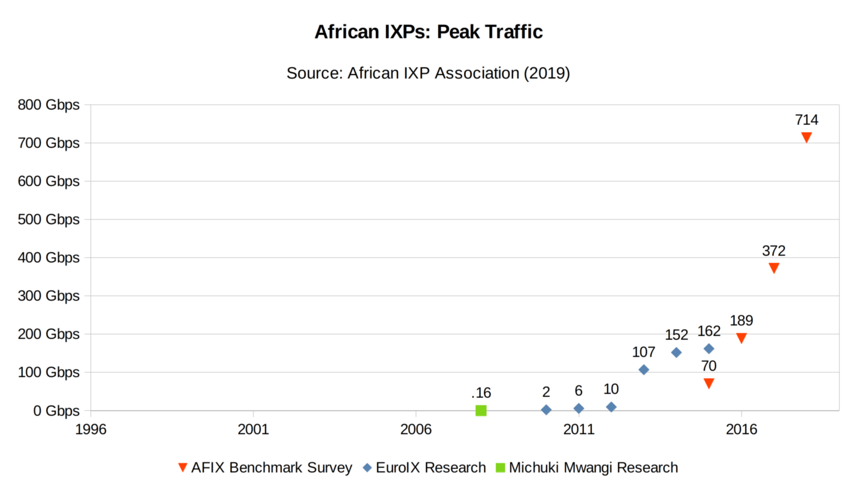

Slide 30
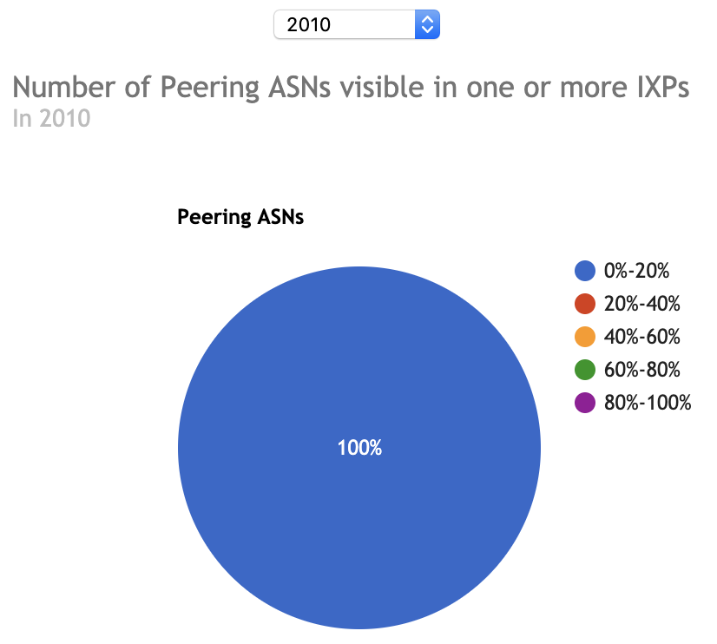
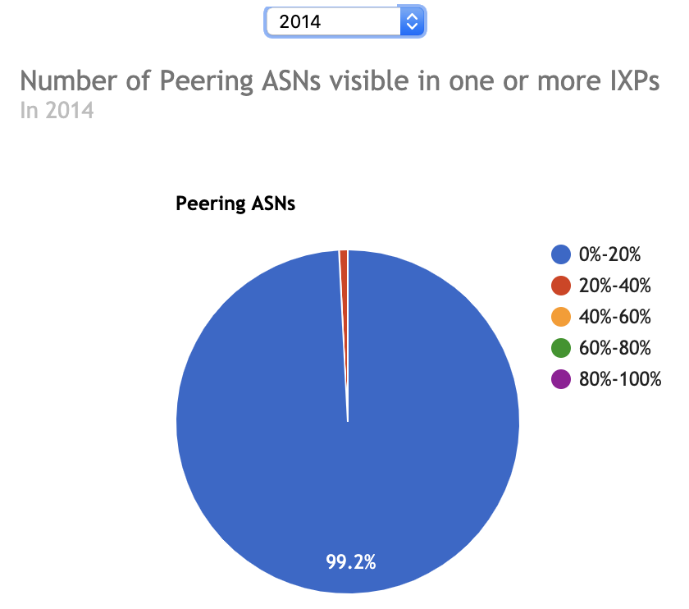
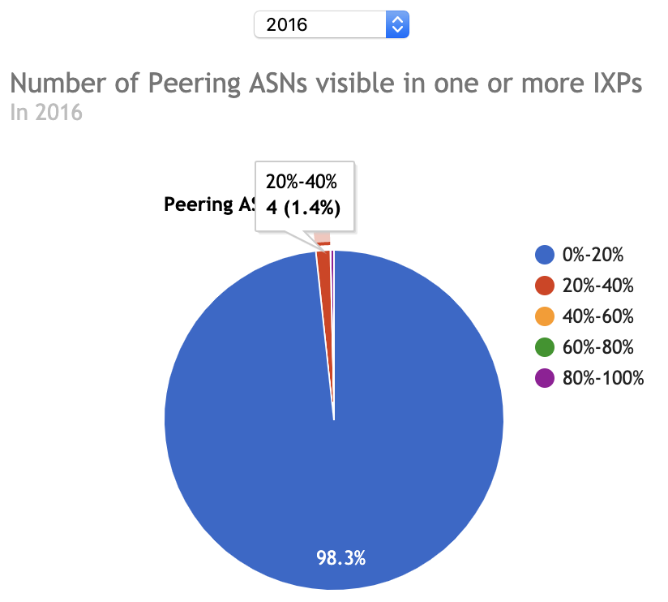
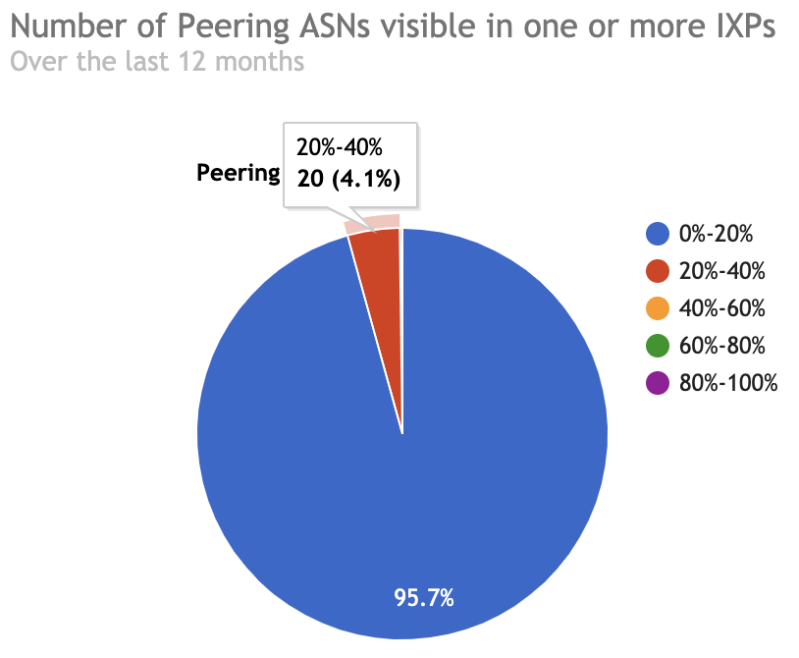
Cross-border Peering of Carriers

Slide 31
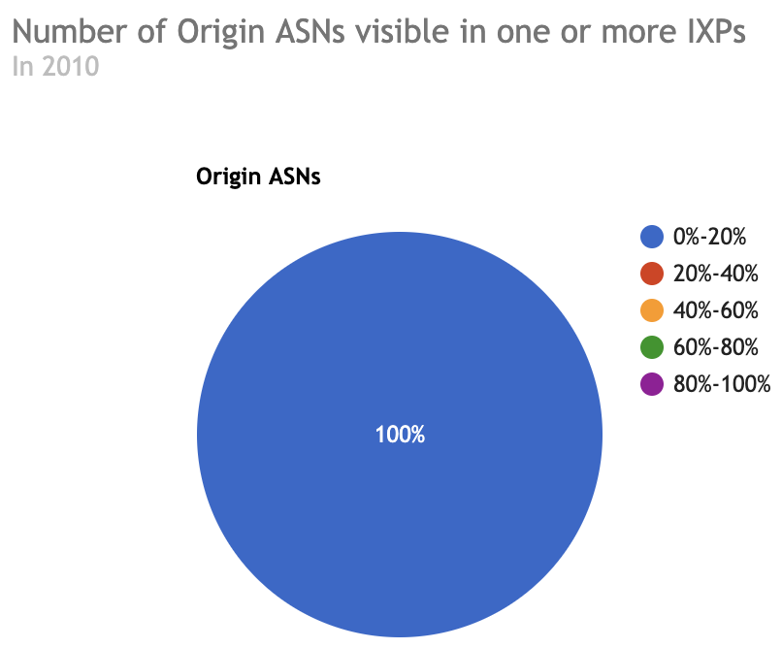
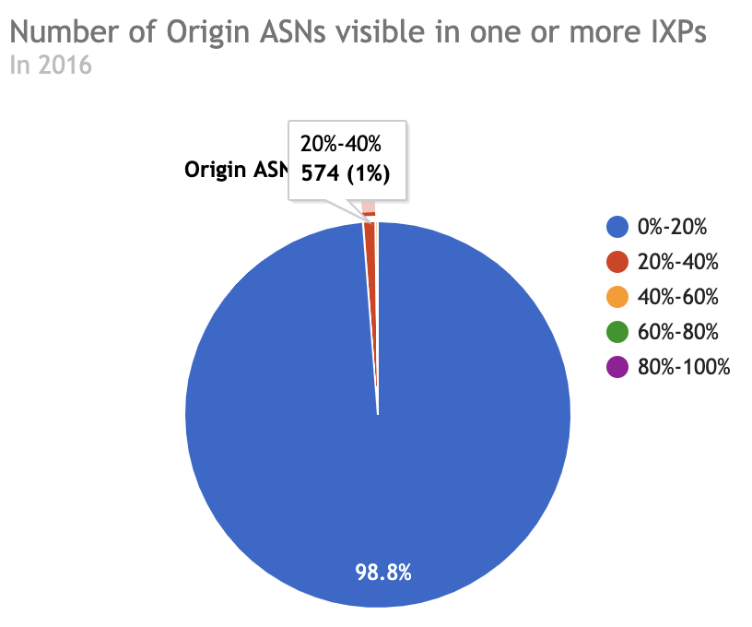
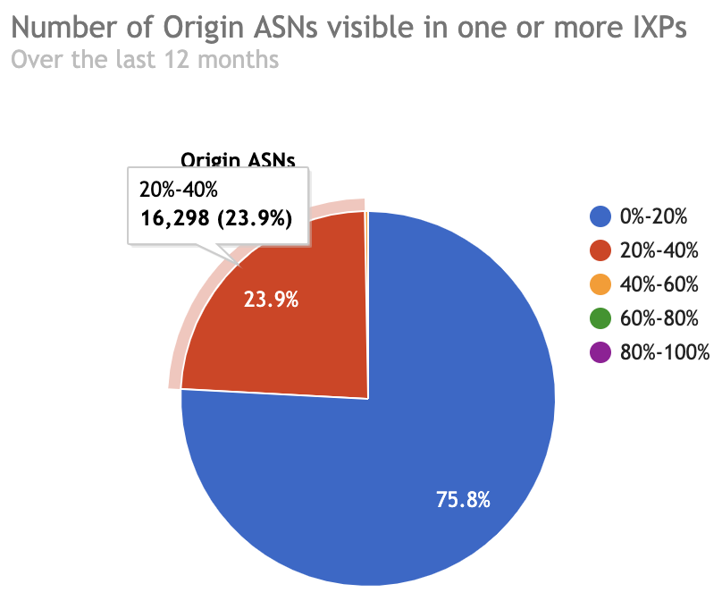
Global and Regional Carriers - Open Peering
SEACOM announced change of peering peering at AFPIF-2015
Entry of global carriers into the African peering ecosystem
Notes:
SEACOM announced change of Peering peering policy at AfPIF 2015 – Open peering policy inside Africa
Entry of HE into Africa (South Africa) in 2016 and other markets in 2017

Slide 32
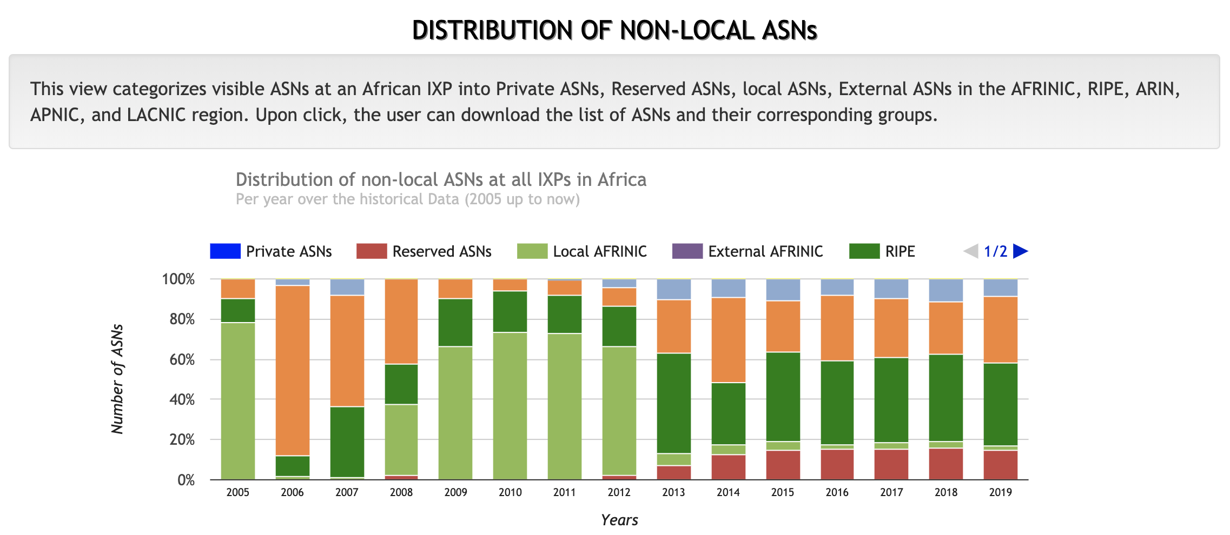
Global ASNs visible at IXPs in Africa

Slide 33
Looking Forward

Slide 34
But the work has just begun…
Progress has been uneven in Africa and participation in AfPIF has also been uneven
Needed goal: To get all countries and African service providers to AfPIF
Education and information sharing efforts still needed
Need to get data center space and community to collaborate with AfPIF
They are mutually dependent
Need to focus on creating a more robust content ecosystem in Africa. (Content, hosting, distribution etc.)
80/20 by 2020. Still far from a reality for some networks, but not all
Need to refocus on policy and regulation
Still have cumbersome legal and regulatory environments in many countries
And new developments happening that might setback progress
Need more data about what is happening in Africa
Better key statistics and peering data
Funding needed for projects to maintain and grow data efforts
Notes:
Explore further how to realize more -- First 10 years was about opening up the space, what more can be done
While we’ve come far -- the progress hasn’t been even. At 10 years we need to think about how we can turn and get to those places that haven't yet gotten on the bus.

Slide 35
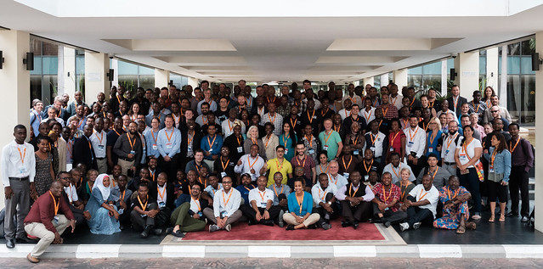
Most importantly …
The future of AfPIF will depend on the community!

Slide 36
Thank You!
Michuki Mwangi Internet Society
Mwangi@isoc.org
Karen Rose Zynia Digital
Karen@zyniadigital.com

