Slide 1
The African Internet in 2030
19th April 2019

Slide 2
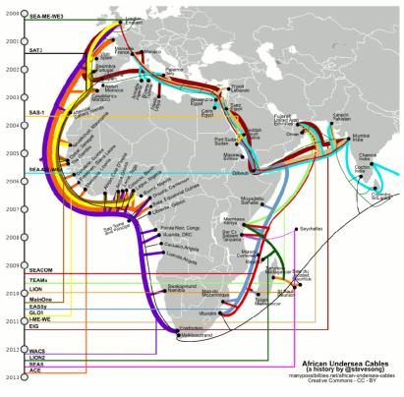
A brief (modern) history lesson
Between 2009 and 2013 there was an explosion of submarine cables around Africa
However…
  The African IXP of choice was LINX
  The cross-border circuits were limited
  There was almost no cross-border peering
  Content served from the continent was extremely limited

Slide 3
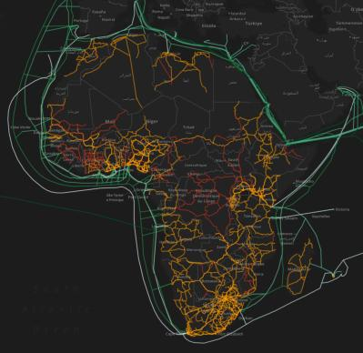
The terrestrial map as it stands
A lot of fiber – and growing. The trick moving forward will be linking it all up.
Recently Liquid achieved the first Cape To Cairo terrestrial circuit – and in even more recent days, connectivity from East to West was announced.
We predict significant growth in the East to West routes – to lower the latencies needed to reach both Asia and the Americas from all parts of the continent.

Slide 4
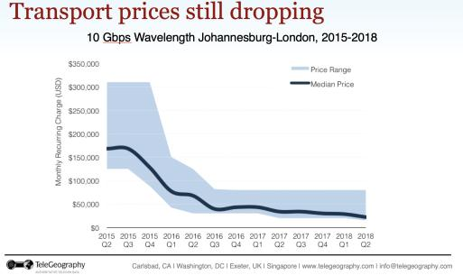

Some trends…
The price per megabit is coming down - in 2002 a megabit of bandwidth in London cost as much as $150 a meg – today its $0.15, so a thousandth of the cost.
We see a similar trend across the continent – and believe that by 2030 we will see price parity with the rest of the world.

Slide 5
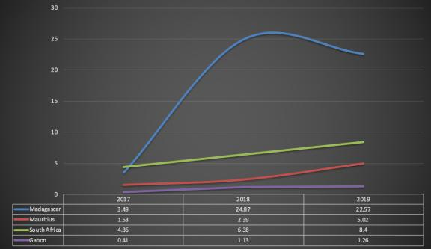
Bandwidth trends…
Bandwidth usage is growing – with some anomalies
Madagascar saw a 546% speed increase in sample tests since 2017
Mauritius saw a 228% speed increase in sample tests since 2017
The islands have started using fiber – rather than satellite!
Gabon and South Africa have seen large FTTH investments
https://s3-eu-west-1.amazonaws.com/assets.cable.co.uk/broadband-speedtest/worldwide-broadband-speed-league-2019-data.xlsx

Slide 6

Fiber penetration is growing.
There is heavy demand for FTTH services – and the growth in FTTH across the continent has been astounding.
Mobile still dominates the African landscape for the consumer market – will that remain? What will the impact of 5G be?

Slide 7

The impact of 5G?
The advent of 5G will result in heavier fiber concentrations
The Future of Wireless is wired https://www.forbes.com/sites/techonomy/2012/04/01/the-future-of-wireless-is-wired/#2f0fb1fde833
Base stations will increase – and the need to backhaul that traffic will result in a flood of fiber.
The complexity of routing and traffic control from the provider perspective will become exponentially more challenging.

Slide 8
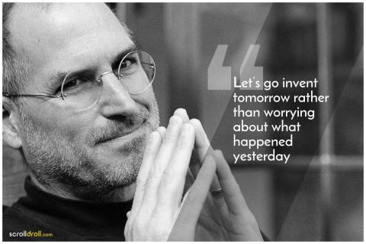
Looking to the future
We see regional hubs have developed on the continent in Johannesburg and Cape Town in South Africa and in Nairobi in Kenya.
We believe a west African hub will appear – but there is no real clarity as to where. Lagos, Abidjan, Accra, Douala – all are options.
The majority of content is likely to be served out of these locations to the countries inland and adjacent to them.
Africa is set to become a transit path – from East to West – it’s the shortest route.
This creates opportunity – and some challenges.

Slide 9

So what keeps us awake at night?
Tax
Shutdowns are becoming more prevalent.
The policy environment is not getting any friendlier – There is one step forwards one (or more) step backwards
Our customers are increasing demanding more flexibility – more control – and higher service levels in an ever-changing environment.
While we dream about the Africa Free Trade agreement

Slide 10
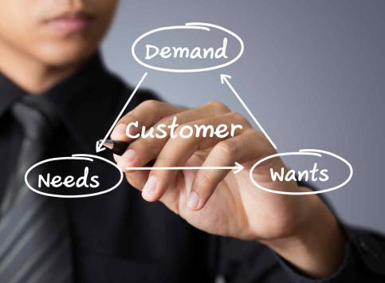
Customer mindset is changing…
Customers are getting smarter
  They want more control
  They want faster response times
  MTTR’s have to improve
Customers demands are changing – driven by more detailed metrics
  Latency
  Cost
  In some cases politics…

Slide 11
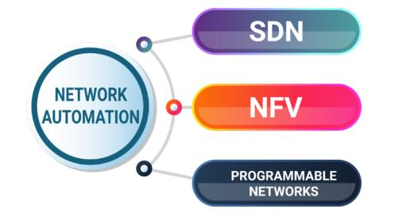
Dealing with the customer of tomorrow
Automation is everything – it is the only answer to 24/7/365 nature of the business
The internet of tomorrow will be:
  Driven by customers – not engineers
  Automated by software – not run by CLI
  The customers will want the control – while the providers mitigate the risks.

Slide 12
The internet of today
Modern networks give customers relatively little control
The provider determines how traffic flows to the customer – and while there is limited ability for the customer to influence this – it is exactly that - limited
Traffic routing was determined by destination
The customer had no control

Slide 13
The internet of tomorrow
Customers will have the ability to steer traffic based on type at the source.
  Content type
  Specific destination
  Specific application
The provider will set the rules – but will pass the control within those rules to the customer.
The customer will steer on requirements – not necessarily with technical know-how – this will have to be done via simple interfaces
Traffic routing will be determined by instructions
From the customer to the source
Traffic Type A
Traffic Type B

Slide 14
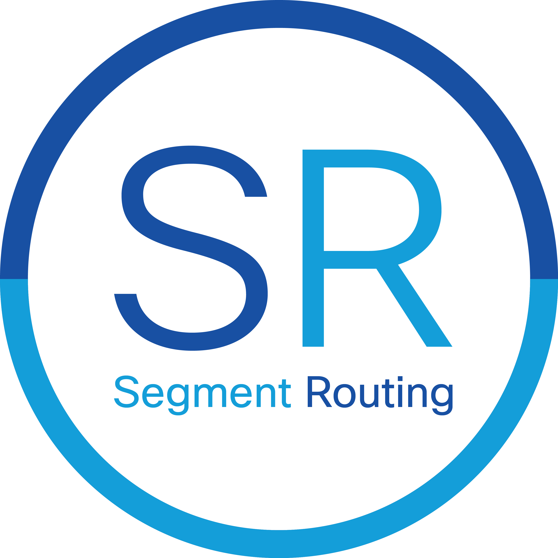

How will this happen?
Customers will choose their paths
Paths will be communicated to the network using BGP extensions from the controller the customer is communicating with.
The logic behind the controllers and their interfaces will be where the provider differentiate
Network programmability is coming…

Slide 15
Network programmability
In the network of tomorrow, the customer will potentially have the ability to instruct the network to perform tasks – programmability is part and parcel of segment routing.
The exact methods in the IPv4 world are clearly defined – if not well deployed
The IPv6 world – is up in the air, there are different approaches – some of which could impose large traffic overhead – so we hope to mitigate this in the standards forums.

Slide 16
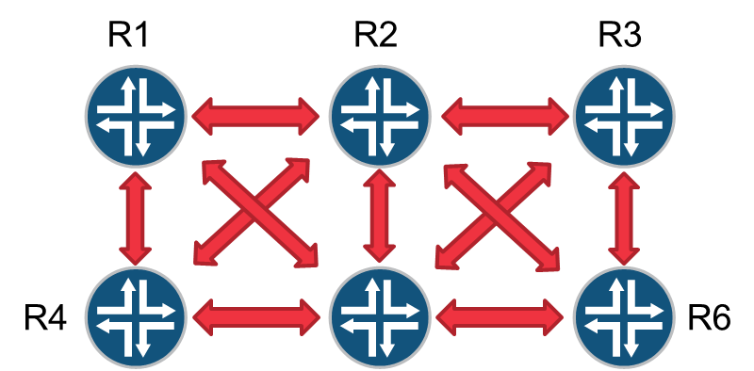
The paradigm shift
As stated earlier – traffic is mostly destination based in todays world. Consider the following – in a normal network – traffic entering R1 will follow the routing table to R6 – which will be calculated using SPF and other manual metrics based on the announcements of R6 – but R6 doesn’t have control beyond itself – to actually dictate the path to it. Want to know where the packet is going – follow the routing table….
Ingress Packet
Egress Packet

Slide 17
The paradigm shift (2)
Assume each of the below routers has a static label – 1 through 6 to represent the 6 routers. We tell R1 – that for prefix X to reach R6 – push label stack 2,5,6.
R1 pushes the stack and the labels are popped as they move through the relevant routers. The traffic pathing is hard set at source – R6 has no say – and the routing table is meaningless. The traffic is routed based on source.
Ingress Packet
Egress Packet

Slide 18
So what’s changed?
Path instructions to R1 are injected via BGP – it is possible to give the customer access to program the path (with limitations you impose).
Looking at an intermediate routers routing table will be meaningless if you don’t take into account the label stack.
The traffic engineering between nodes is effectively lose routed – meaning it follows the IGP to get to the next label.
You can push a path to a router – and then stack labels on a *host* base – without affecting the rest of your network routing – so – a customer can announce a /24 - with a single host taking a different path – should they need to for specific purposes.
So how much control do you want to give your customers? The balance could be tricky.

Slide 19
The V6 conundrum
IPv6 is supported on SR-MPLS – except certain vendors have stated that MPLS must die with IPv4 – and are proposing SRv6. We disagree – MPLS is a part of life that isn’t practical to remove.
SRv6 imposes as much as a 19% overhead on traffic – dropping 19gigabit out of every 100gigabit of traffic in pure packet headers.
There are two competing proposals – no agreement on either side – and a resistance by one side to inter-op.
Africa has to take a stand – V4 is running out – and if we don’t have MPLS in the v6 world, we have a significant problem. So what works for Africa? Our views can be found at: https://www.linkedin.com/pulse/srv6-why-we-want-andrew-alston/

Slide 20
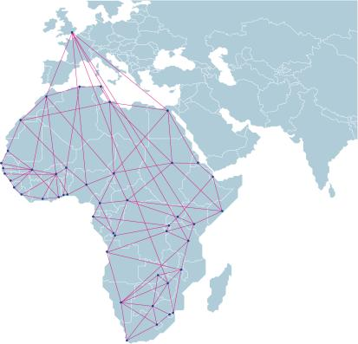
Why does this matter to Africa?
Running flexible networks is a change in mindset – engineers will have to adapt
The hardware choices we make will impact our abilities tomorrow, more than ever below
The protocols are new and being developed – we have to ensure the African needs are met within the standards.
Networks must be designed to our customers needs – rather than dictated by what the rest of the world is doing.

Slide 21

Paving the future roads of tomorrow
By 2030 if we play our cards right
  The lack of legacy technology will allow us to leapfrog much of the rest of the world
  Our skills base can be founded in technologies developed for our needs – rather than skills imported from elsewhere on technologies that don’t solve our problems

Slide 22

Where to from here?
With the vendors and content providers looking to Africa for new customer bases and new sources of revenue – so comes opportunity.
We believe in a future where we have two choices – accept what the rest of the world has asked for – or use our position as a massive emerging market to make our case for what we need
I believe we need to take the latter – that is what is good for Africa.

Slide 23

Some final thoughts
With a market evolving as fast as this one – the time for being passive is over – we have to seize control of our own destiny and get involved.
We have to innovate – or we will be crushed by those that do.
We as network engineers have to learn – or with the advent of AI – the machines will out learn us – to our detriment.
We are the next billion people unconnected – that’s a massive market – and we need to leverage that.

Slide 24
Thanks!
Questions Welcome!
Andrew.Alston@liquidtelecom.com

