Slide 1
The Shifting Connectivity Landscape in Africa
And its effect on interconnection hubs
Patrick Christian
Analyst, TeleGeography

Slide 2
What we’ll cover
Subsea landscape
What is shaping subsea demand and why
What role do content players play
Where are the new routes
Points of convergence
Where networks are coming together in Africa and why
What affects the growth of new hubs
Where are they and will they be

Slide 3
Subsea Landscape

Slide 4
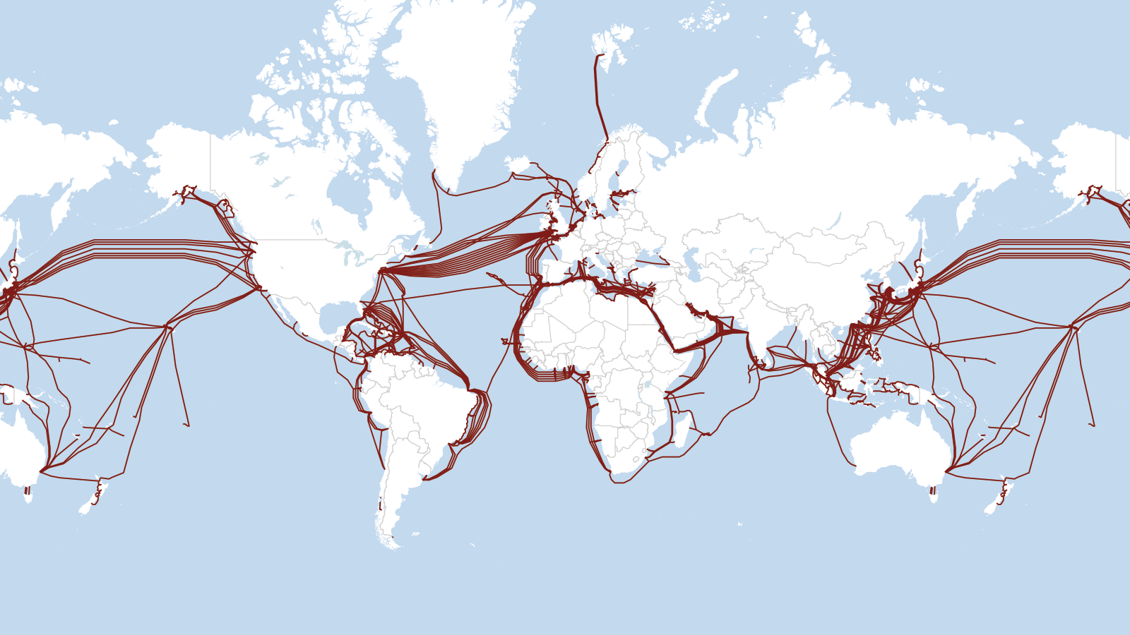
Sub cable systems pre-2016
Carlsbad, CA | Washington, DC | Exeter, UK | Singapore | www.telegeography.com | info@telegeography.com

Slide 5
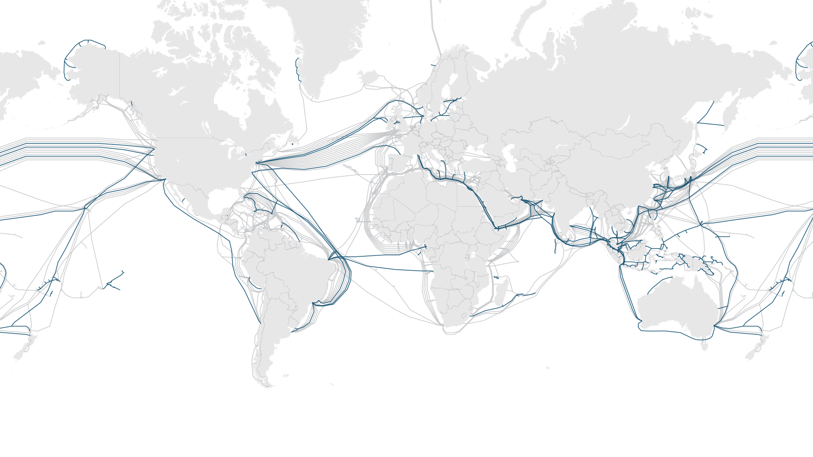
New cable systems 2016-2019
Carlsbad, CA | Washington, DC | Exeter, UK | Singapore | www.telegeography.com | info@telegeography.com

Slide 6
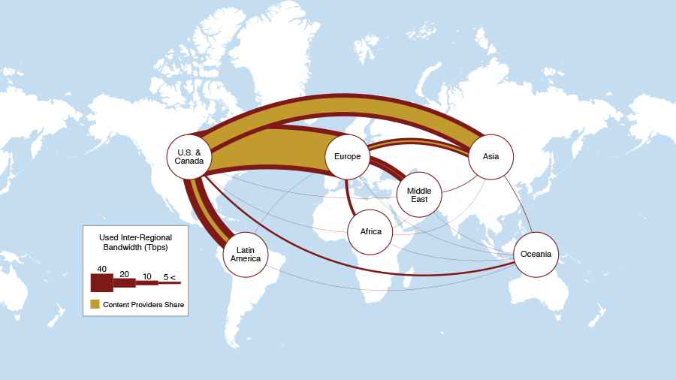
What’s in those sub cables
Used inter-regional bandwidth showing content provider share, 2019
Carlsbad, CA | Washington, DC | Exeter, UK | Singapore | www.telegeography.com | info@telegeography.com

Slide 7
Content share depends where
Share of Used Bandwidth by Category for Major Routes, 2018

Slide 8
Content bandwidth growth
Content Providers versus Others Bandwidth Growth by Region, 2014-2018

Slide 9
So how does this affect new sub systems?
Inter-data center demand (DC to DC)
DC location emphasis on cost (favorable regulatory environments, affordable power, or other cost-saving measures)
Surge in bandwidth on traditional routes, plus new landings to some smaller markets
Irish landings in two of the newest trans-Atlantic cables GTT Express and AEC-1 connecting to AWS, FB, Google data centers
Content distribution and cloud services (DC to user)
Emphasis on distribution to end user so from DCs to major hubs and secondary hubs
Smaller bandwidth requirements than inter DC but a larger number of locations must be connected, not just a few large data centers
Capacity extending to secondary developed markets and major emerging markets

Slide 10
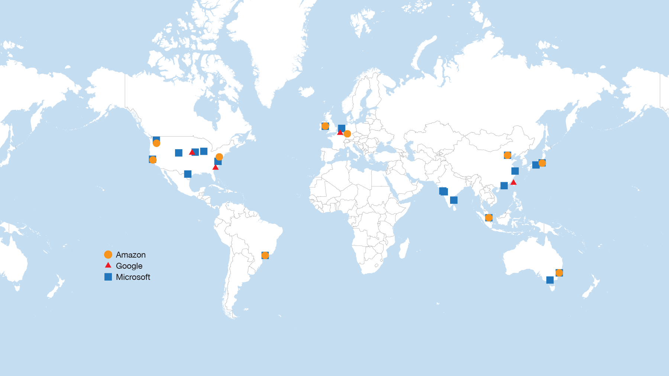
Cloud data centers 2006-2015
Carlsbad, CA | Washington, DC | Exeter, UK | Singapore | www.telegeography.com | info@telegeography.com

Slide 11
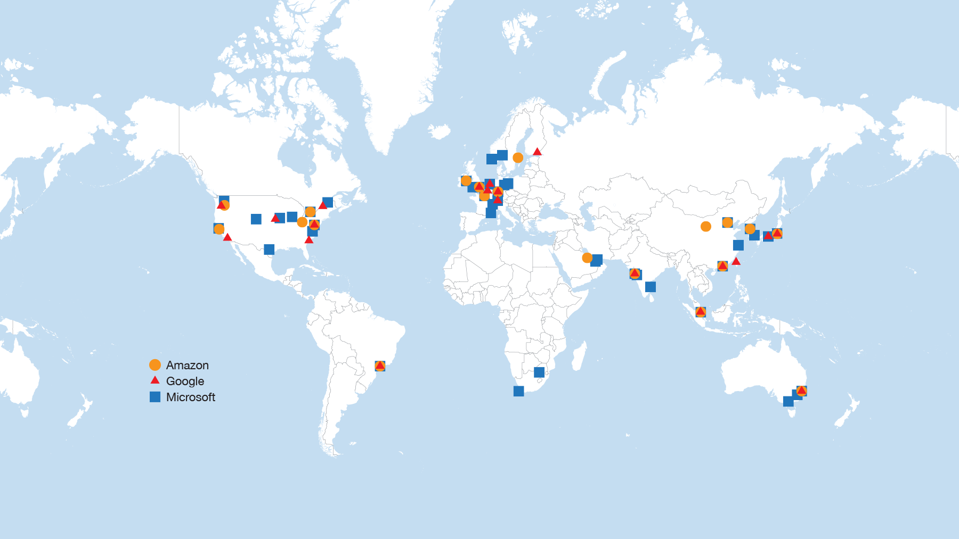
Cloud data centers current & planned
Carlsbad, CA | Washington, DC | Exeter, UK | Singapore | www.telegeography.com | info@telegeography.com

Slide 12
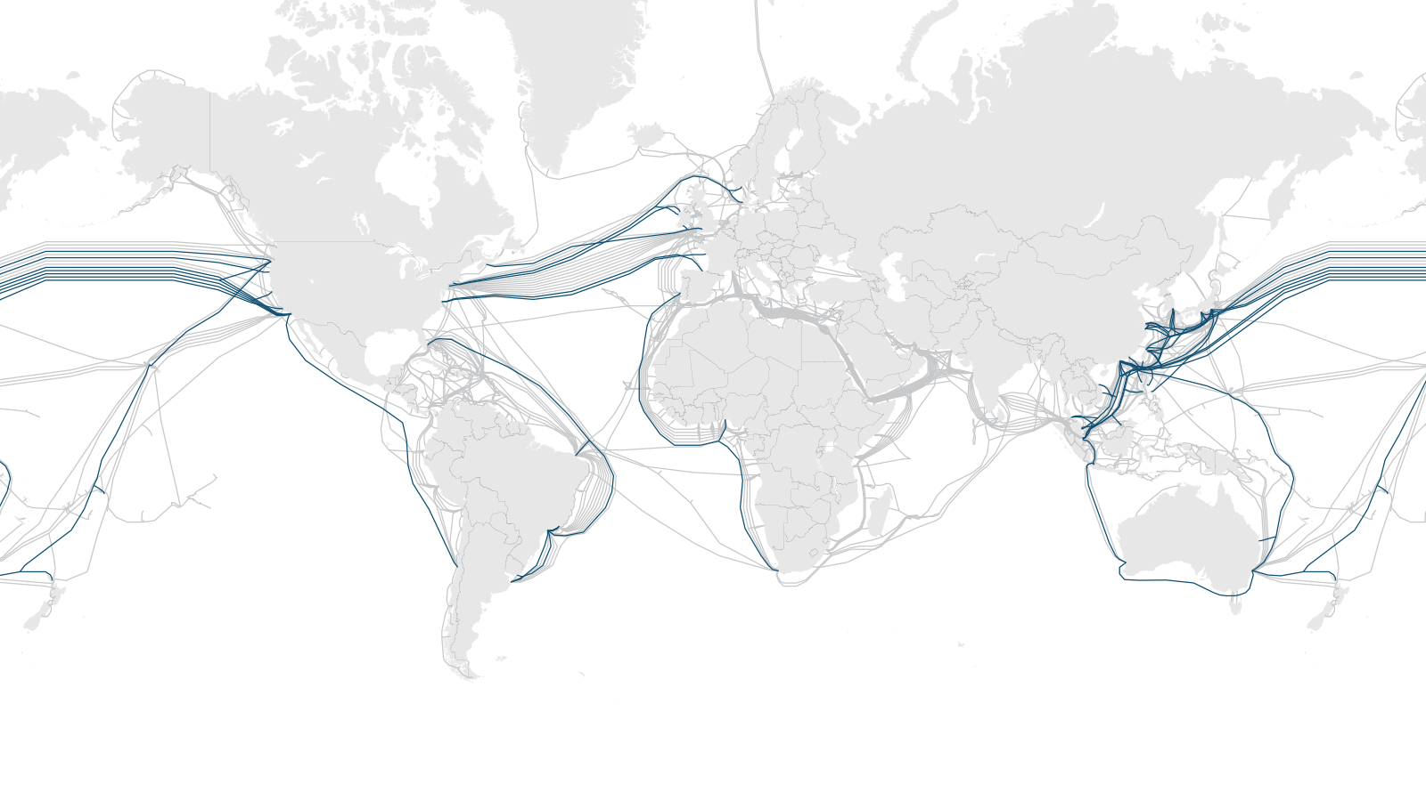
Content provider submarine cable investments
Carlsbad, CA | Washington, DC | Exeter, UK | Singapore | www.telegeography.com | info@telegeography.com

Slide 13
New sub cable investment
Construction Cost of New Sub Cables Entering Service by Region, 2016-2021

Slide 14
Africa

Slide 15
Sub-Saharan Africa
Int’l Internet Bandwidth Growth – Sub-Saharan Africa

Slide 16
Increasing intra-Africa connectivity
Share of international connectivity by region

Slide 17
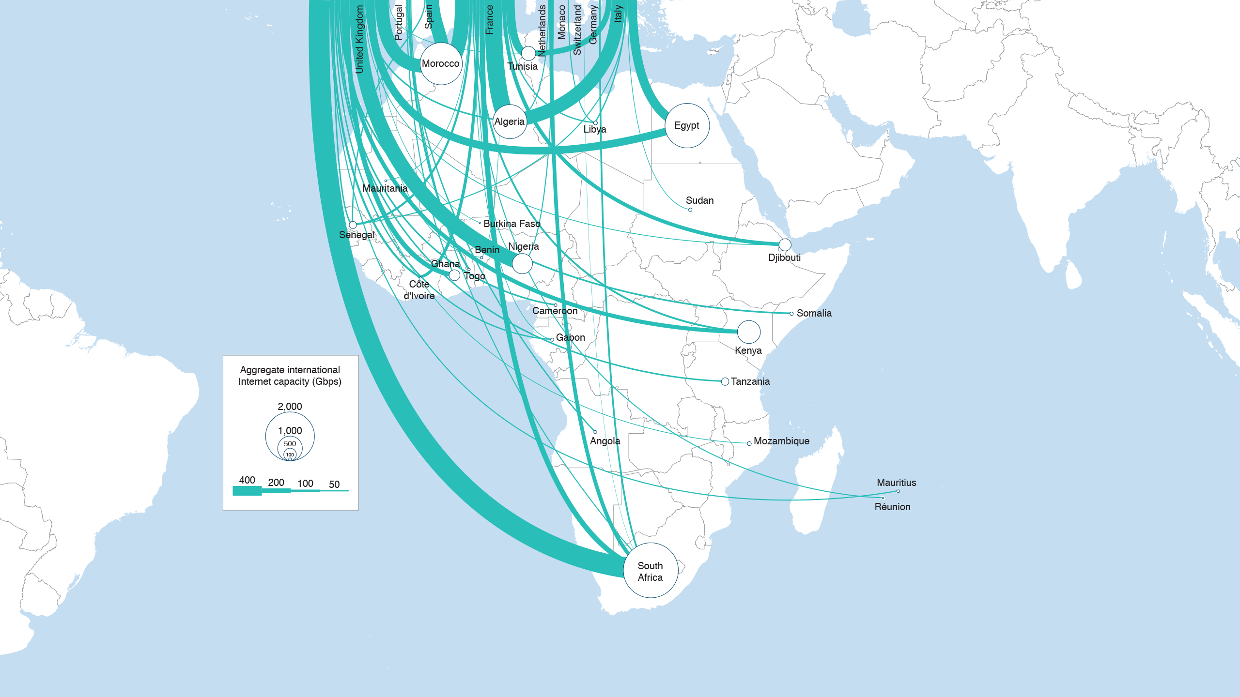
Connecting to content in Europe
Major International Internet Routes in Africa, 2019
Carlsbad, CA | Washington, DC | Exeter, UK | Singapore | www.telegeography.com | info@telegeography.com

Slide 18
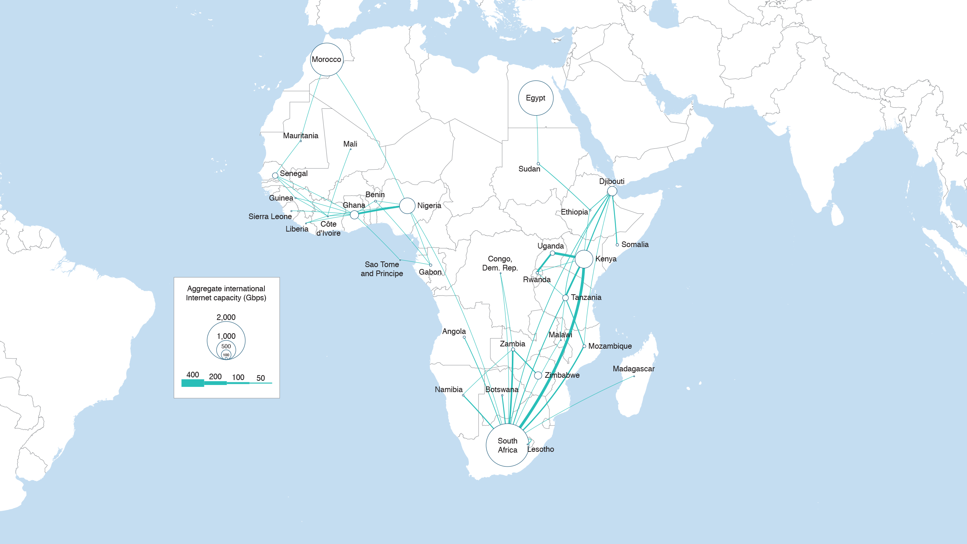
Intra-African Routes, 2018
Carlsbad, CA | Washington, DC | Exeter, UK | Singapore | www.telegeography.com | info@telegeography.com

Slide 19
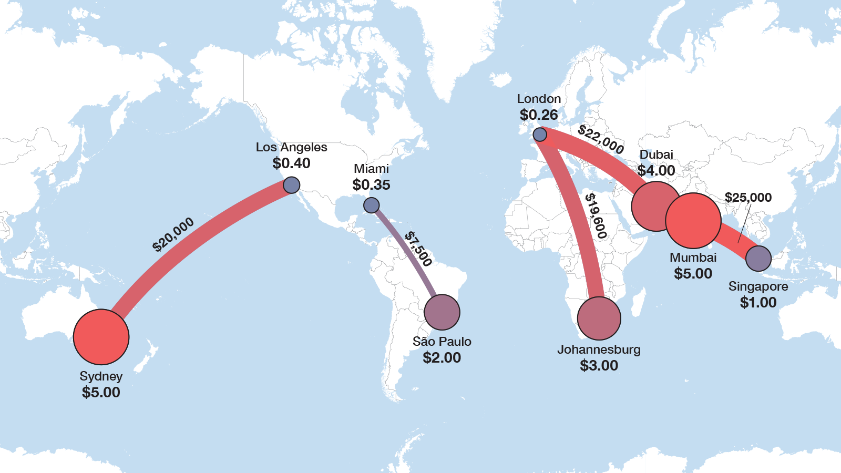
How much where? Prices by geography
10G Wavelength MRC, 10G IPT Port MRC, Q1 2019
Carlsbad, CA | Washington, DC | Exeter, UK | Singapore | www.telegeography.com | info@telegeography.com

Slide 20
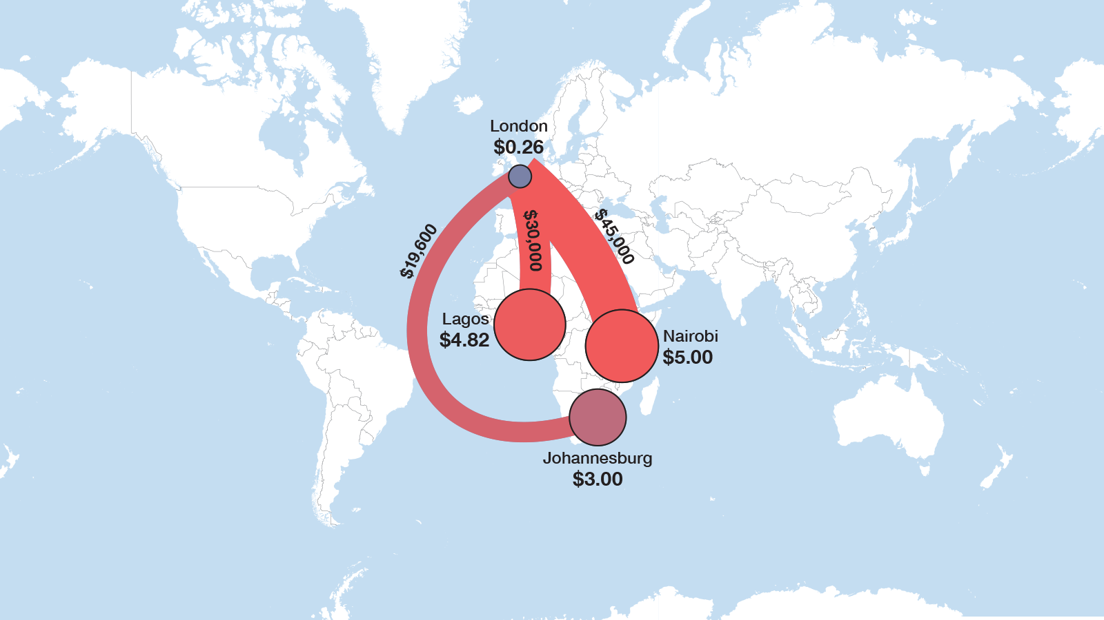
Africa to Europe
10G Wavelength MRC, 10G IPT Port MRC, Q1 2019
Carlsbad, CA | Washington, DC | Exeter, UK | Singapore | www.telegeography.com | info@telegeography.com

Slide 21
Points of convergence

Slide 22
Factors for new interconnection hubs
International bandwidth (subsea cable systems)
Carrier-neutral DCs and IXs
Friendly regulatory environment
Competition-low prices for local connectivity
Rich ecosystem-cables, content, ISPs, corporations

Slide 23
Int’l IP capacity growth by country
 | 2019 Bandwidth, Gbps | CAGR, 2015-2019
Africa Top IP Bandwidth
Johannesburg | 1,125 | 64%
Lagos | 816 | 61%
Cape Town | 803 | 53%
Nairobi | 583 | 62%
Djibouti City | 484 | 44%
Accra | 429 | 64%
Mombasa | 347 | 39%
Abidjan | 307 | 43%
Dar Es Salaam | 293 | 36%
Dakar | 282 | 68%
Kampala | 189 | 51%
Africa Top IP Growth
Cotonou | 88 | 77%
Kigali | 92 | 75%
Libreville | 113 | 71%

Slide 24
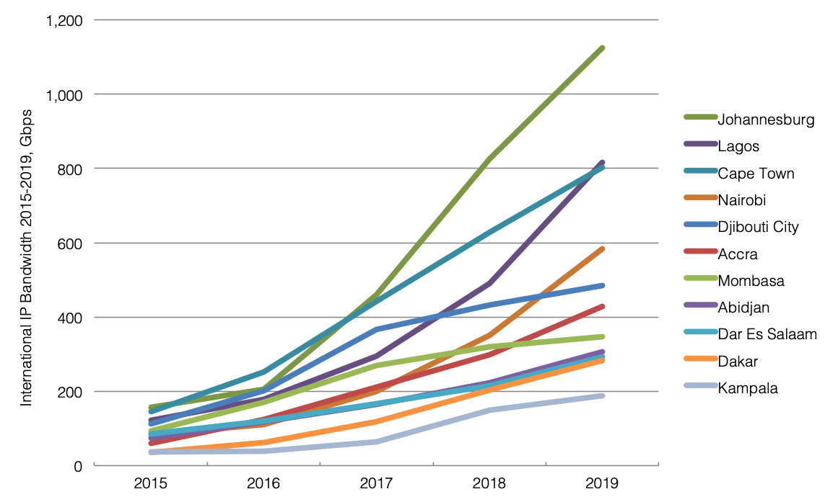
Int’l IP bandwidth growth by city

Slide 25
Prices vary by region
10 Gbps Wavelength Lease Price Q2 2018 & Q2 2019

Slide 26
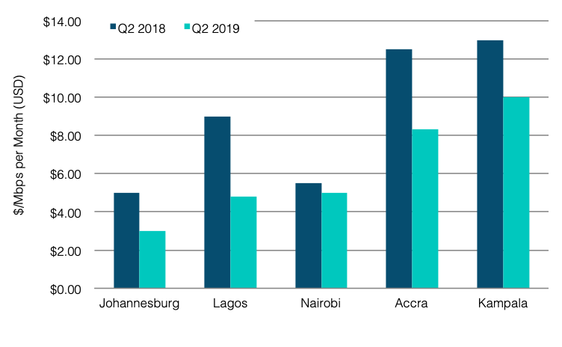
IPT prices per Mbps

Slide 27
African Internet Hubs, 2019
Carlsbad, CA | Washington, DC | Exeter, UK | Singapore | www.telegeography.com | info@telegeography.com

Slide 28
Hubs and Hubs? (all well connected to sub systems but…)
Cape Town/Jo’burg vs Lagos
Different levels of local competition (pricing) and reg environment
Mombasa vs Nairobi, Accra vs Lagos?
Transit hub vs local interconnection hub
Djibouti vs Mombasa/Nairobi
Onward connectivity to…
Kampala vs Kigali
Abidjan and Dakar?

Slide 29
Summary
Content providers are influencing new subcable builds
Connecting DCs to DCs (traditional routes) and DCs to end-users (some traditional routes plus new routes to emerging markets)
Do new international subsea systems create new interconnection hubs?
No. It is just one of many factors. Or ok, first step to get things started
So what is the magic mix to create new hubs?
Depends. In emerging markets, carrier-neutral DCs/IXs, regulatory environment, local competition, large local market and rich ecosystem are as important as sub cables. Developed markets… a different story

