Slide 1
Unlocking the Potential of the
Indian Ocean Islands
AFPIF 2019

Slide 2
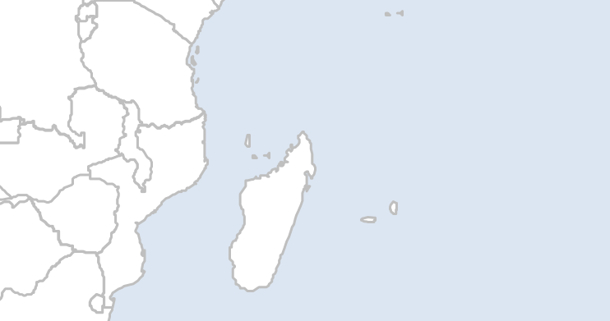
The Sub-Saharan Indian Ocean Islands
Widely Spread Islands…

Slide 3
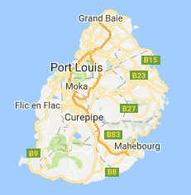
MAURITIUS

Slide 4





Fast Facts - MAURITIUS
ECONOMY
TELECOMMUNICATIONS
Population: 1,26 M
GDP 2018 : 14,22 B$
GDP/capita : 11,693 $
Growth 2018 : 3,8%
% Pop using Internet : 86%
Internet Growth Rate 2000 to 2019: 824%
National Fiber Backbone: 3
Submarine Cable: 2
4G Operators: 3
ECONOMIC DRIVERS
Financial Services
Tourism
ICT
Manufacturing & SME

Slide 5
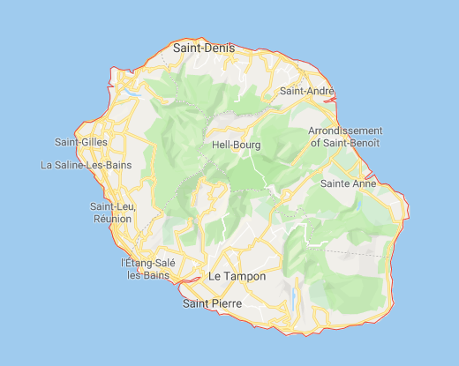
REUNION

Slide 6





Fast Facts - REUNION
ECONOMY
TELECOMMUNICATIONS
Population: 0.85 M
GDP 2018 : 25,33 B$
GDP/capita : 26,972 $
Growth 2018 : 3,2%
% Pop using Internet : 53.9%
Internet Growth Rate 2000 to 2019: 269%
National Fiber Backbone: 1 – OPEN ACCESS
Submarine Cable: 2
4G Operators: 4
ECONOMIC DRIVERS
Agriculture
Tourism
Manufacturing
Notes:
La Reunion Numérique

Slide 7
MADAGASCAR

Slide 8




Fast Facts - MADAGASCAR
ECONOMY
TELECOMMUNICATIONS
Population: 25 M
GDP 2018 : 12,1 B$
GDP/capita : 470 $
Growth 2018 : 4,2%
% Pop using Internet : 9.80%
Internet Growth Rate 2000 to 2019: 8710%
National Fiber Backbone: 1
Submarine Cable: 2
4G Operators: 4
ECONOMIC DRIVERS
Agriculture
Tourism
Textile
Mining
Notes:
National Fiber Backbone: 1
Telma – CLOSED ACCESS

Slide 9
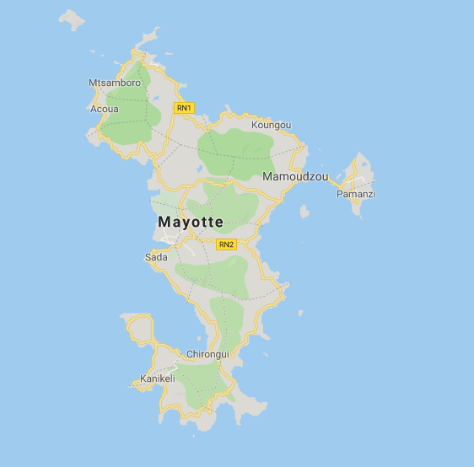
MAYOTTE

Slide 10
Fast Facts - MAYOTTE
ECONOMY
TELECOMMUNICATIONS
ECONOMY
Population: 0,26 M
GDP 2018 : 3,3 B$
GDP/capita : 12,800 $
Growth 2018 : N/A
% Pop using Internet : 40.5%
Internet Growth Rate 2000 to 2019: N/A
National Fiber Backbone: 1
Submarine Cable: 3
4G Operators: 3
ECONOMY DRIVERS
ECONOMIC DRIVERS
Agriculture

Slide 11
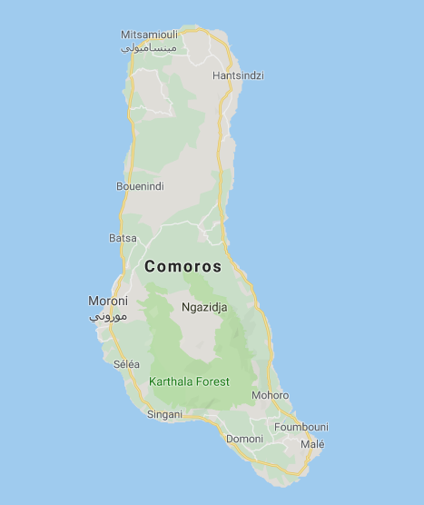
COMOROS

Slide 12

Fast Facts - COMOROS
ECONOMY
TELECOMMUNICATIONS
Population: 0.853 M
GDP 2018 : 1,203 B$
GDP/capita : 833 $
Growth 2018 : 2,8%
% Pop using Internet : 15.3%
Internet Growth Rate 2000 to 2019: 8605%
National Fiber Backbone: 1
Submarine Cable: 3
4G Operators: 2
ECONOMIC DRIVERS
Tourism
Agriculture

Slide 13
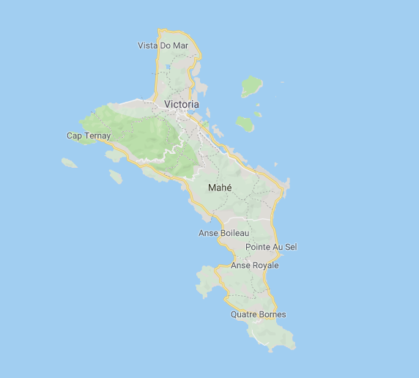
SEYCHELLES

Slide 14


Fast Facts - SEYCHELLES
ECONOMY
ECONOMY
TELECOMMUNICATIONS
Population: 0,096 M
GDP 2018 : 1,59 B$
GDP/capita : 17,154 $
Growth 2018 : 8.5%
% Pop using Internet : 70%
Internet Growth Rate 2000 to 2019: 1018%
National Fiber Backbone: 1
Submarine Cable: 1
4G Operators: 2
ECONOMY DRIVERS
ECONOMIC DRIVERS
Tourism
Agriculture
Energy

Slide 15
Indian Ocean Islands and Sub-Saharan Africa
Country | Madagascar | Mauritius | Reunion | Seychelles | Comores | Mayotte | Total/Average | Sub-saharan Africa
Population (M) | 25 | 1.26 | 0.85 | 0.096 | 0.853 | 0.256 | 28.315 | 1000
GDP per Capita (USD) | 470 | 12 | 26,972 | 17,154 | 833 | 12,800 | 1,944 | 1,681
GDP growth (%) | 4.2 | 3.8 | 3.2 | 8.5 | 2.8 |  |  | 2.8
Adult Literacy rate (%) | 71.57 | 93.6 | 94.5 | 95.2 | 77.7 |  | 73.5 | 65
Internet Penetration index (%) | 9.8 | 86.3 | 53.9 | 70.1 | 15.3 | 40.5 |  | 39.8
In 19 years Africa usage of internet increased by 11,532% while the rest of the world it’s 88.1%. Africa contribute to 11.9% of Internet usage

Slide 16
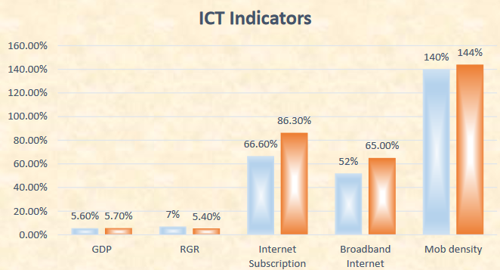
ICT in Indian Ocean
The Islands of Indian Ocean islands represent a population of nearly 28.3 millions inhabitants. Sub-Saharan Africa - 1B
Evolving market conditions are creating a big demand for high speed broadband
Broadband has positive impact on GDP growth, Employment growth and Productivity (ITU,2012)
Focus on new technologies such as AI, Blockchain & FinTech, IoT …
Double the university intake for ICT courses
Public sector service digitalization
Cyber threat response at national level
Work from home incentives
ICT Indicators – 2017/18 - Mauritius

Slide 17

Enablers that shape the Internet Ecosystem?
International Connectivity
Consumers
Content
Consumption Growth
Digital Transformation
National Backbone
IXPs
Regulation
& Governance

Slide 18
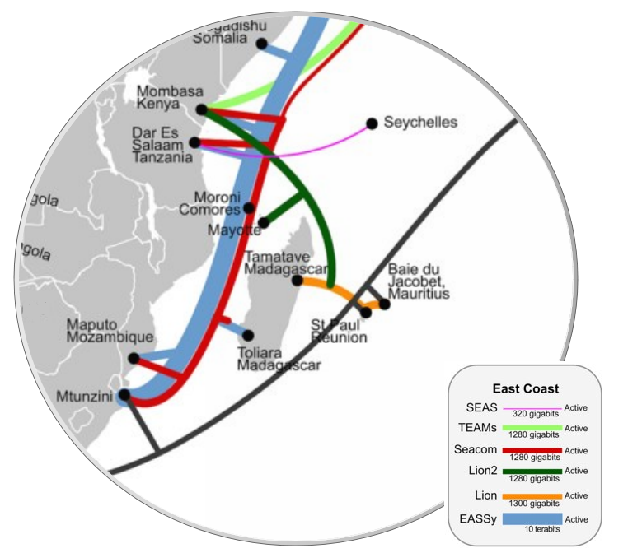
International Connectivity
SAFE Cable
Commissioned in 2002
Closed Access
Connectivity: Mauritius, Reunion Island, South Africa, Malaysia
LION/LION2 Cable
Commissioned in 2009 & 2012
Closed Access
Connectivity: Mauritius, Reunion Island, Madagascar, Mayotte, Kenya
EASSy Cable
Commissioned in 2010
Closed Access
Connectivity: Madagascar, Comores, Mozambique, South Africa
https://manypossibilities.net/african-undersea-cables/

Slide 19
R
Lack of path diversity
2 cables only
Ageing SAFE Cable
17 years already
I
High cost for wet segment and cross connect
S
Closed access
Lack of regional connectivity
K

Slide 20
Vision for the Region
Introduction of a 3rd Submarine Cable!!!
A Cable for Indian Ocean islands
to trade with Africa

Slide 21
Why a third Cable?
High capacity to meet demand for next 25 years
Direct access to South Africa, hub for the African Internet
Enable Peering and Cloud access in South Africa
Make Inter-Island connectivity simpler, Open Access.
Reduce International Bandwidth Costs
Reduce Cross Connect Costs
Terminate in Carrier Neutral DC in South Africa
Access to current and future East and West African cables.

Slide 22
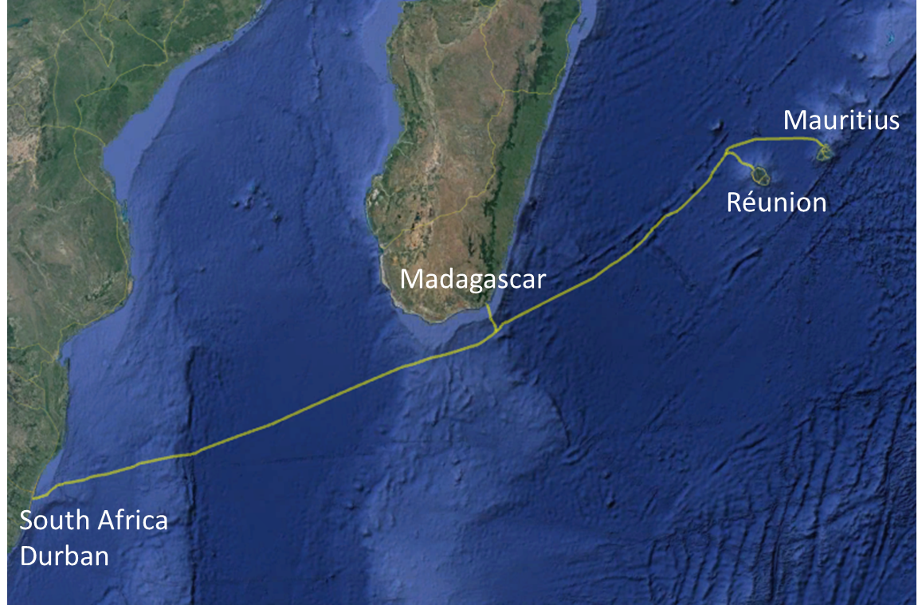

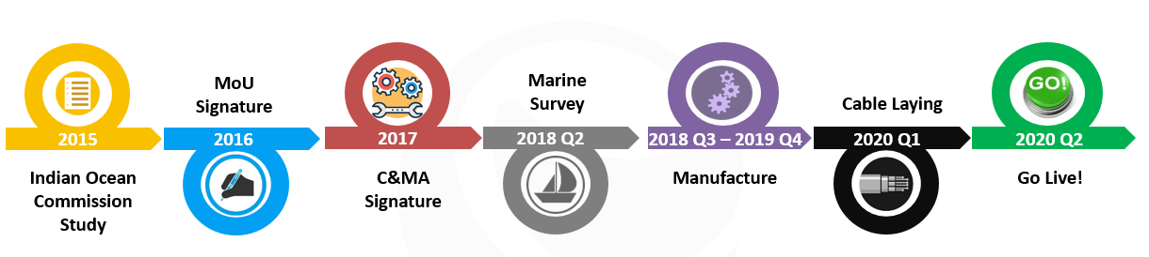
The 3rd Submarine Cable
Cable characteristics
Design Life: 25 years
Technology: Repeated
Number of fiber pairs: 2 FP
Equipped FP: All
Design capacity: 24,000 Gbps
Activated capacity: 1,000 Gbps
Branching Unit: 2 Repeater: 32
Regional collaboration between 6 operators to make it happen!

Slide 23
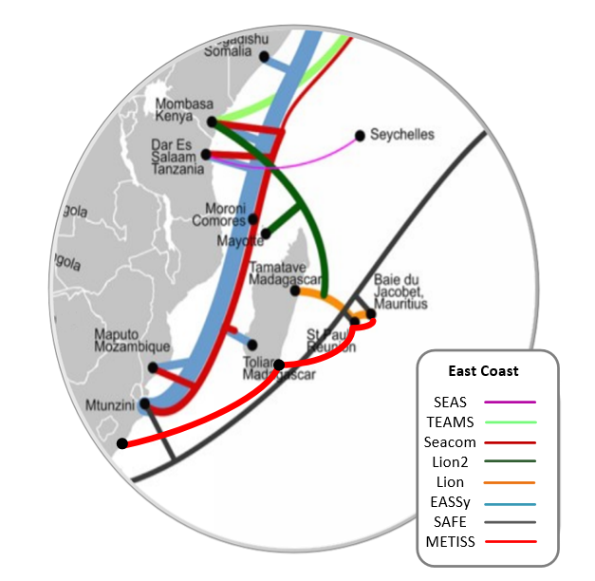
Other Cables

Slide 24
How this will change the internet landscape.
Confirm the islands as major ICT hubs
Better internet access for all social classes
Enabler for industry 4.0
Increase productivity in SMEs
Empowerment
Creates higher demand in throughput
Low
Prices

Slide 25
What else are we doing?

Slide 26
The Total Enabling System
Domestic Connectivity
Data Centers
International Connectivity

Slide 27

Internet Exchange Points
Challenges
Initiatives
Emtel has revised its peering strategy to be 100% Open
Educate the society of IXP importance
Fully involve in MIXP 2.0
Extending IXP infrastructure to more accessible Data Centres
One of main sponsor for IP Transit at IXP
Aspire to be a regional IXP
Negligible traffic despite >10 years of existence
Lack of understanding by local community
Limited participation of key player
Physical location
Exchange of local traffic at negligible cost

Slide 28
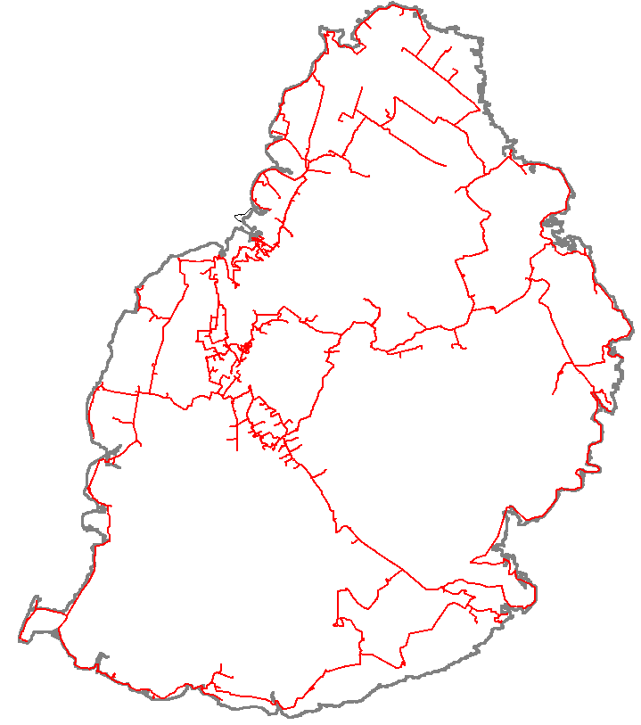
National Backbone
Challenges
Initiatives
Closed access – no fiber unbundling
High cost of deployment.
Lengthy deployment.
Access issues [Right of way, trespassing….]
Massive investment in the national fibre
New generation of micro-trenching
Fast deployment. 200Km in less than 1 Year

Slide 29

Content Hosting
Challenges
Initiatives
Limited critical services hosted locally
High colocation cost
Regulatory framework for Data Centre interconnectivity
Shared major contents for the country
Tier 3 carrier neutral data centre
Promote affordable local content hosting
CDNs hosting

Slide 30
Thank You…

