Slide 1
In Search of Low Cost Mobile Bandwidth to Provide Improved Connectivity to Underserved Areas
Niall Robinson, 22.08.2017

Slide 2
The Problem Statement
Internet not available with acceptable bandwidth in less densely populated areas in Africa
Hinders user social media experiences
Mobile is the best medium to deliver high speed internet connectivity in rural areas
What’s needed?
  Low cost solutions including optimized backhaul
  Small footprint
  Standardized and scalable solution for all nodes

Slide 3

Reference Model
CP
Building
Cab.
CO
Main CO
Core CO
Mobile Core CO
UE
NT
PSTN
BTS
MSC
NB
Access
Router
eNB
Nx GbE
EPC
Service creation for all services incl. BRAS functions and LER IP edge functions.
BSC
PER
RNC
IPSec
GW
UE
NT
BTS
WDM-
PON
LER
NB
IP/MPLS/OTN Backbone
eNB
Nx GbE
Internet
UE
BNG
BTS
NT
Radius
Server
NB
Nx GbE
Control Platform
eNB

Slide 4
Reference Model
CP
Building
Cab.
CO
Main CO
Core CO
Mobile Core CO
UE
NT
PSTN
BTS
MSC
NB
Access
Router
eNB
Nx GbE
EPC
Service creation for all services incl. BRAS functions and LER IP edge functions.
BSC
PER
RNC
IPSec
GW
UE
NT
BTS
WDM-
PON
LER
NB
IP/MPLS/OTN Backbone
eNB
Nx GbE
Internet
UE
BNG
BTS
NT
Radius
Server
NB
Nx GbE
Control Platform
eNB

Slide 5




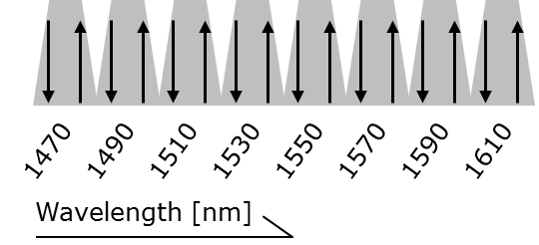
LTE base station connectivity
Technology selection
Technology: Coarse WDM Single Fiber Working
Optimized for outdoor environment
  20nm CWDM grid is substantially wider than the 0.8nm DWDM grid
  Laser can drift freely for temperatures up to +85°C
  Passive filter technology
Negligible asymmetric delay – Meets LTE requirements by design
  By using CWDM BiDi both transmission directions have exactly the same fiber length
Both directions accommodated in one CWDM slot
BiDi
CWDM
CWDM
Filter
One
Fiber
CWDM
Filter
BiDi
CWDM
Single element filter

Slide 6

2 x 1GE SFW CWDM Bidi
East West
East West
East West
East West
8x
16CSM/P-
Up to 2 x 1G per site
East/West protection
Single fibre strand
λ 1 – λ8
8x
λ 1 – λ8
16CSM/P-
East West
East West
East West
East West

Slide 7
2 x 1GE SFW CWDM Bidi
East West
East West
East West
East West
8x
16CSM/P-
Up to 2 x 1G per site
East/West protection
Single fibre strand
λ 1 – λ8
8x
λ 1 – λ8
16CSM/P-
East West
East West
East West
East West

Slide 8
2 x 1GE SFW CWDM Bidi
East West
East West
East West
East West
8x
16CSM/P-
Up to 2 x 1G per site
East/West protection
Single fibre strand
λ 1 – λ8
8x
λ 1 – λ8
16CSM/P-
East West
East West
East West
East West

Slide 9
2 x 1GE SFW CWDM Bidi
East West
East West
East West
East West
8x
16CSM/P-
Up to 2 x 1G per site
East/West protection
Single fibre strand
λ 1 – λ8
8x
λ 1 – λ8
16CSM/P-
East West
East West
East West
East West

Slide 10
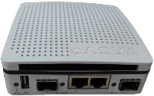
Hub Site Configuration
eNodeB Configuration
8x
Y cable filter
16CSM/P-
λ 1 – λ8
Passive solution
8x
West
East
λ 1 – λ8
CWDM Bidi directly plugged into aggregation device
16CSM/P-
Single interface BiDi CWDM SFP
Y cable filter
XG120
16CSM/P-
Active solution
West
East
16CSM/P-
BiDi CWDM SFP plugged into FSP150
Traffic terminated on FSP150 GE120 and aggregated into 1/2 x 10G interfaces

Slide 11
2 x 10GE SFW CWDM Bidi Up to 8 access nodes on single fibre
East West
East West
East West
East West
8x
Up to 2 x 10G per site
East/West protection
Single fibre strand
16CSM/P-
λ 1 – λ8
8x
λ 1 – λ8
16CSM/P-
East West
East West
East West
East West

Slide 12
Hub Site Configuration
eNodeB Configuration
8x
Y cable filter
16CSM/P-
λ 1 – λ8
Passive solution
8x
West
East
λ 1 – λ8
16CSM/P-
CWDM Bidi directly plugged into aggregation device
Single interface BiDi CWDM SFP directly plugged into eNodeB

Slide 13



2 x10GE Active solution
Hub Site Configuration
eNodeB Configuration
CWDM Bidi directly plugged ADVA Transponders
8x
Y cable filter
16CSM/P-
Media converter/1HU 5WCA transponders
λ 1 – λ8
8x
Active 10GE solution
West
East
λ 1 – λ8
Single interface BiDi CWDM SFP
16CSM/P-
10GE Demarcation/ Transponders
IP/MPLS/OTN Backbone
2 x 10GE 850nm MM
16 x 10GE handoff to backbone
Standard “grey” multimode handover to eNodeB

Slide 14
Voyager – Packet Optical Solution
Voyager
Voyager is an Open Optical Packet Transport box
The design for both hardware and software has been submitted to TIP, the Telecom Infra Project making this available to all
Voyager is a 1RU pizza box packet-optical solution.
  It has Layer 2 Forwarding Engine and Layer 3 Routing capabilities
ADVA supplies Voyager hardware and software – either:
  As a standalone entity for integration into disaggregated networks
  Integrated with ADVA Open Optical Layer and Management System
  Both options will be integrated into ADVA Commercial and Service offerings

Slide 15
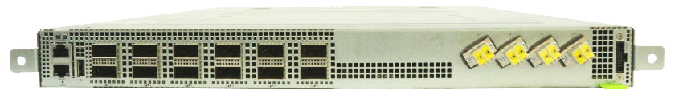
2 x10GE Active solution with Voyager
Hub Site Configuration
eNodeB Configuration
CWDM Bidi directly plugged ADVA Transponders
8x
Y cable filter
16CSM/P-
Media converter/1HU 5WCA transponders
λ 1 – λ8
8x
Active 10GE solution
West
East
λ 1 – λ8
Single interface BiDi CWDM SFP
16CSM/P-
10GE Demarcation/ Transponders
4 x 10GE per QSFP port
2 x 10GE 850nm MM
Voyager - Layer 2 Forwarding Engine and Layer 3 Routing capabilities
4 x 200G Coherent DWDM connection to backbone
Standard “grey” multimode handover to eNodeB

Slide 16
Solution Comparison
Deployment restrictions
Limited Management
1GE
Active
Easy deployment
Active Management
1GE
Passive
10GE based solutions deliver lowest bandwidth cost and highest capacity
Active solution slightly more expensive than passive but has easier deployment and management attributes
Voyager can provide a cost effective multi-layer interface to IP/MPLS backbone
Cost per GE
10GE
Active
10GE
Passive
2GE
20GE
Total bandwidth per eNodeB

Slide 17
Solution Expansion:
Active monitoring of Fiber Plant
The integrity of the access fiber is monitored by measuring the reflection of a laser at 1650nm that is co-propagated with the traffic signal(s)
Normal Operation
Fiber-cut detection
Rayleigh
scattering
Demarcation
Reflector
Rayleigh
scattering
Fiber-cut
Reflectance
Reflectance
Distance
Distance
The optical power of the reflection from the CPE/Far-end demarcation is monitored
The intensity of the reflected demarcation peak provides an estimate of the insertion loss of the link
A fiber cut or increased insertion loss is detected as this reduces the demarcation reflection peak
By measuring the Rayleigh scattering power the location of the fiber-cut can be detected

Slide 18
Summary
Very lost cost, low resource consumption backhaul network architectures are possible using a combination of:
  Pluggable optics
  Single fiber working (BiDi) architectures
  Open source packet optical platform Voyager
Solution extensions include:
  Protection capabilities for redundant path operation. Increases cost but also increases network resiliency
  Dual fiber working (if fibers are more readily available)
  Low cost fiber monitoring capabilities to continuously monitor fiber quality / link availability
Further cost optimizations are under study

Slide 19






Thank You
Niall Robinson
Vice President
Global Business Development
Phone: +1 972 759 1262
Fax: +1 972 759 1201
Mobile: +1 978 933 1081
nrobinson@advaoptical.com
ADVA Optical Networking NA. Inc.
2301 N. Greenville Avenue
Suite 300
Richardson, TX 75082
USA
www.advaoptical.com
IMPORTANT NOTICE
The content of this presentation is strictly confidential. ADVA Optical Networking is the exclusive owner or licensee of the content, material, and information in this presentation. Any reproduction, publication or reprint, in whole or in part, is strictly prohibited.
The information in this presentation may not be accurate, complete or up to date, and is provided without warranties or representations of any kind, either express or implied. ADVA Optical Networking shall not be responsible for and disclaims any liability for any loss or damages, including without limitation, direct, indirect, incidental, consequential and special damages, alleged to have been caused by or in connection with using and/or relying on the information contained in this presentation.
Copyright © for the entire content of this presentation: ADVA Optical Networking.

Slide 20
Backup Slides

Slide 21
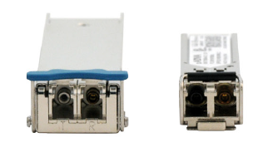
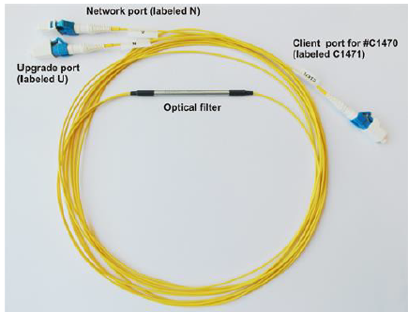
Passive vs Active
Direct Optics Radio Vendor
Demarcation/transponer Based
10G XFP
BiDi CWDM
1G SFP
BiDi CWDM
Radio equipment independent of CWDM interfaces
Pluggables, directly connected to radio equipment
1CSM+#Cxxxx
1GE/10GE demarcation / 10GE Transponders
East West
East West
Line
East
Line
West
Line
East
Line
West
Filter in cable assembly
Filter in cable assembly

Slide 22
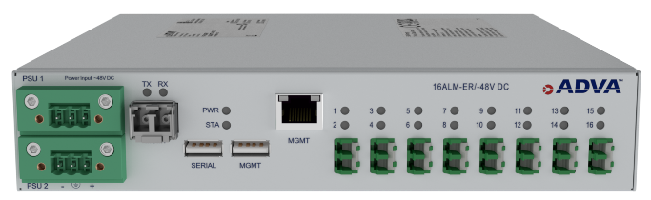
Key Features and Benefits
Service agnostic OTDR technology for 24x7
in-service fiber link monitoring
Cost-optimized solution for real-time service
assurance
Automated fiber fault detection, localization
and notification
Ease of use featuring intuitive GUI, integrated with various GISs, open SNMP-based NBI, integrated into the ADVA Network Management System
Proven technology, deployed with major fixed and mobile network operators
Unique in-service fiber monitoring: cost-efficient, fast and reliable

