Slide 1
Interconnect Evolution
An African IXP and colocation experience in scaling for growth

Slide 2
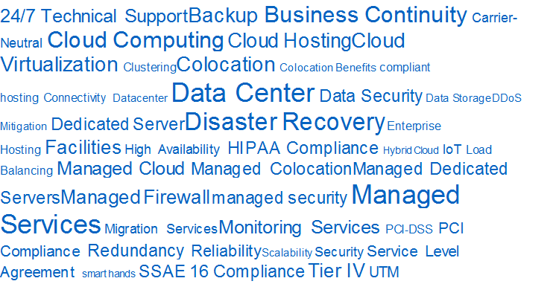
What commercial people say

Slide 3
What technical people say

Slide 4
Colocation has become more than space & power
Interconnection is one of the most important features to look for in a data centre provider, these are the key aspects to review:
Access - Data centre interconnection provides access to multiple Carrier/ISPs
Convenience - Data centre interconnection providers also offer the benefit of a direct, physical connection between servers, providers, and customers.
Interconnection Policies - Carrier-neutral data centres are not confined to any one service provider and generally colocate a successful IXP
Pricing - non-carrier-neutral environment = high pricing or access only allowed the carrier’s service options
Location - High-performance interconnects and access to quality networks are two of the most vital considerations when selecting a colocation provider.
Notes:
Access
Data center interconnection provides access to multiple ISPs – which are especially crucial if the customer is selling globally. By having access to many service providers, international customers are able to exhibit a strong presence both domestically and worldwide, and in turn are able to expand their customer base and enhance business operations.
Additionally, data centers with an array of connectivity options often allow direct access to their servers – which is instrumental in the case of an outage or maintenance window for hardware and/or software.
Convenience
Data center interconnection providers also offer the benefit of a direct, physical contact point between servers, providers, and customers. This advantage is important because it allows the customer to not only navigate from point A to point B, but to do so more quickly and with more flexibility than a traditional provider. These qualities are essential for the execution of everyday business operations.
Additionally, the flexibility of an interconnected data center allows providers to continually improve their services and offerings in order to meet customer expectations. By eliminating data bottlenecks, interconnected providers are able to establish a solid IT infrastructure that can be scaled indefinitely, and – perhaps most importantly – can accommodate the consumer demand for flexible, cost-efficient growth.
Interconnection - Carrier-neutrality is one of the most significant advantages of an interconnected data center provider. By offering the ability to choose from multiple carrier options, customers are able to cultivate one of the most critical components of the purchasing journey – choice.
Pricing
In a traditional or non-carrier-neutral environment, a customer is only allowed one service option. This fixed structure can reap negative consequences for the customer as they become subject to a variety of similarly defined factors including limited bandwidth, high pricing, and a lack of competition.
Location
Facility location affects data center interconnection more than you might expect. High-performance interconnects and access to quality networks are two of the most vital considerations when selecting a colocation provider. However, without a strategic location, these benefits can be compromised. Internet exchange points overlap across the globe and different locations yield different connectivity offerings depending on their positioning in these pathways.

Slide 5
Neutral colocation client vs interconnect growth
YEAR | INTERCONNECTS | CLIENTS | AVE. INTERCONNECT/CAB
2010 | 300 | 23 | 2
2011 | 879 | 53 | 2
2012 | 1163 | 93 | 2
2013 | 2017 | 132 | 2
2014 | 3392 | 180 | 3
2015 | 5578 | 219 | 4
2016 | 7122 | 280 | 4
2017 | 8624 | 348 | 4

Slide 6
Increased Market Diversity = Complex Cabling
Interconnection 2015 - 2016
Notes:
As a neutral colocation provider seeks to diversify it’s marketplace into different segments. Cabling becomes more complex to service between buy and sell members between the data centre e.g. financial trading market has regulations on cabling requirements e.g. each member connecting to a stock exchange all have to the same cable length

Slide 7
NAPAfrica overview: AS37195
3 Regions: Johannesburg (Avg: 126Gbps, Peak: 205Gbps), Cape Town (30G), Durban (3G)
Members: 270 unique ASN’s
Port Sizes: 1G/10G/100G
559Active Ports – ~2.4Tbps connected capacity
Pricing: Free (Ports, Membership, Cross Connects)
Policy: Open to all
Multi-lateral peering arrangements available;
Bi-lateral peering arrangements available
IPv4 & IPv6 enabled
Notes:
7

Slide 8
NAPAfrica Growth 2016 to 2017
July 2016
IXP | 1G Ports | 10G Ports | Total | Connected Capacity
NAPAfrica IX JHB | 177 | 88 | 265 | 1057G
NAPAfrica IX CPT | 87 | 28 | 115 | 367G
NAPAfrica IX DBN | 41 | 8 | 49 | 121G
Total | 305 | 124 | 429 | 1545G
July 2017
IXP | 1G Ports | 10G Ports | Total | Connected Capacity
NAPAfrica IX JHB | 199 | 156 | 355 | 1759G
NAPAfrica IX CPT | 97 | 46 | 143 | 557G
NAPAfrica IX DBN | 50 | 11 | 61 | 160G
Totals | 346 | 213 | 559 | 2476G
Notes:
8

Slide 9
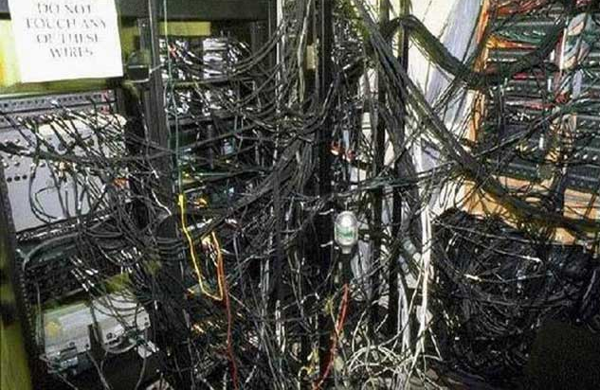
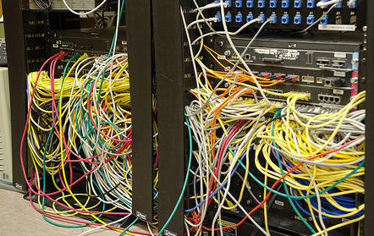
Massive growth = operational challenges
Notes:
Generally cabling strategies are not reviewed when migrating or deploying into a colocation facility

Slide 10
Infrastructure considerations
Continued growth through new membership and member migration to higher port speeds, increased structured cabling, larger MMR’s = Large Capex
Global Content operators requiring 100G infrastructure
New product requirements through virtual cross connection
Long term scalability at the least cost – Capex, ongoing support and licensing
Purely focused on switching infrastructure and no requirement for full feature sets
System Automation and integration requirements
Reduce complexity due to limited staff resources
Great existing reference sites required
Notes:
10

Slide 11
IXP: Vendor considerations
All major vendors where reviewed e.g. Cisco, Extreme, Arista, Juniper
How did Arista win?
Ticked all the infrastructure considerations boxes at the best bang per port buck
Notes:
11

Slide 12
IXP: Migration experience
Why did we migrate? Virtual chassis environment could not scale to the massive growth, new product and membership requirements.
Bundling multiple 10Gbps ports
Biggest bottleneck was interconnecting old platform to new platform at sufficient bandwidth.
80Gpbs AE limitation on old platform meant we had to carefully plan and move networks to ensure we remained below 90% capacity.
Moving too much content or eyeballs at one go meant congestion would shift in opposite direction.
At the same time, we took on a number of content networks on the new platform, and at times were running > 90% capacity between platforms.
Used sflow to plan optimal moves – combination of content and eyeballs at the same time. Currently at ~30% utilisation between platforms
Notes:
12

Slide 13
Lessons learned
100G is real and there is demand for it now (Price drops have made 40G redundant for anything other than parallel breakouts for 10G density)
Multimode optics are cheap, but make absolutely no sense at 100Gbps given structured cabling requirements (Unless you are using AOC for short distances)
Shop around for your SFP’s and remember to make sure vendor of choice does NOT lock you in
Make sure you understand the costs of upgrade before partnering with a vendor
Various standards available: LR4, SR4, IR4, PLR4, CRL4, etc. (IEEE, MSA). Make sure you know what standard your members use. Some optic vendors mix IR4 with CWDM4 or CLR4.
Plan ahead. Introducing high capacity members to a network means most members will need to upgrade quickly.
Notes:
13

Slide 14
Virtual Cross connection a is reality for Colocation Operators
Layer 2 overlay, Layer 3 underlay with ECMP
Can be point-to-point or point-to-multipoint
Instant, client controlled activation of virtual circuits
Multiple circuits per physical cable
Fewer ports, fewer physical cables, less power, more efficient cooling
Per circuit monitoring using industry standard sFlow
Client controlled bandwidth allocation
No waiting for facility cabling
Less people inside the facility, meaning less chance of physical disruption
Notes:
DATA CENTER INTERCONNECTION TECHNOLOGIES Most network designers would prefer that data center interconnection over wide area networks (WAN) be performed at layer 3, without layer-2 connectivity spanning data centers. However, application requirements often make it necessary to provide layer-2 interconnection between data centers, with common IP subnets and VLANs stretched across sites. While it is true that some VM mobility solutions have removed the need to provide layer-2 connectivity between locations, many current solutions still require layer-2 interconnection. This is also true of many high availability clustering systems and storage virtualization and replication solutions, which mandate layer-2 adjacency between physical nodes. However, native, long-distance, layer-2 connections such as local area network (LAN) extension services can be extremely difficult to find, especially outside of metropolitan areas or at distances that ensure data centers are adequately geographically dispersed to provide full protection from outages. Even where native layer-2 services are available, it may be undesirable to use them due potential “fate-sharing” between sites, as in the case of a layer-2 problem such as a broadcast storm on one site impacting the other data center. PSEUDOWIRE & TUNELLING SOLUTIONS The challenges associated with providing cost-effective, long-distance layer-2 interconnection led to the development of a set of solutions based on tunneling mechanisms. These were designed to allow layer-2 traffic to be transported over Layer-3 networks. Originally these solutions centered on the concept of a “pseudowire,” which allowed for the emulation of point-to-point Ethernet links by tunneling all traffic over wide area networks. Tunneling mechanisms such as Generic Router Encapsulation (GRE), Layer-2 Tunneling Protocol (L2TP), or Multi Protocol Label Switching (MPLS), provided the underlying framework for this approach. Unfortunately, the initial solutions that emerged in this space, such as EoGRE (Ethernet over GRE), EoMPLS (Ethernet over MPLS), AToM (Any Transport over MPLS) did not scale well. For example, to allow any-to-any communication across multiple sites, full mesh connectivity of point-to-point tunnels links was required. As a result, they proved difficult to ARISTA DESIGN GUIDE DATA CENTER INTERCONNECTION WITH VXLAN 5 deploy and very complex to troubleshoot. Also, due the unfiltered transmission of all traffic, these solutions did not deliver the necessary level of fault isolation between locations. In order to overcome some of the limitations of the point-to-point tunneling approach described above, technologies such as Virtual Private LAN Service (VPLS) were developed to allow the multipoint emulation of LAN services over underlying pseudowires. While this solution addressed some of the challenges associated with earlier approaches, in that it allowed multipoint connectivity and offered improved fault isolation between sites, it added the complexity associated with the underlying MPLS infrastructure necessary to support it. In recent years, much of the industry effort to find a simple, robust, multipoint mechanism for carrying layer-2 traffic over layer-3 networks has polarized into distinct camps, with very little cross-vendor support. These solutions, which include OTV (Overlay Transport Virtualization) from Cisco, and Juniper’s EVPN (Ethernet Virtual Private Network), have aimed to address customer requirements for DCI solutions, but have lacked any widespread support from other vendors, essentially locking customers into a single supplier for their inter-datacenter connectivity. Even within the individual vendors, support for their respective solutions can be very limited, often restricted to high-end and costly devices; for example, Cisco’s OTV is only available on the Nexus 7000 platform with M-series modules and the ASR 1000 router

Slide 15
Virtual Cross Connection Benefits
The benefits are:
Immediate and real time activation of services between customers
Less physical infrastructure
Ability to proactively monitor connections
Improved service levels
Improved performance
Cost effective
No Contractual Obligations – Great solution for POC’s and back up route for Primary Physical Cabling

Slide 16
Virtual Cross Connect Interface Demo
Live demonstration of turning up a circuit… click on the icon below

Slide 17
Thank you
Andrew Owens
andrew@teraco.co.za

