Slide 1
IPv6 @ Cloudflare (and v6 related items) AfPIF Abidjan – August/2017
Martin J. Levy @ Cloudflare

Slide 2
// Personal Introduction

Slide 3
Martin J. Levy @ Cloudflare
// Personal Introduction
MY HISTORY A dedicated IPv6 evangelist. Long time TCP/IP developer/programmer, network operator, peering expert, IETF member, NANOG member, and IP networking development/strategy expert.
MY TERSE RESUME Bell Labs (New Jersey) – Unix for Unix’s sake, TCP/IP (1982/1983)
Random startups and ISPs (Bay Area)
Concentric/XO (Bay Area) – IP backbone and hosting
Telecom Italia (Rome & Miami) – Global IP backbone
Hurricane Electric (Bay Area) – Global IPv4/IPv6 backbone
Cloudflare (Bay Area) – Global CDN, DDoS, DNS, Security

Slide 4
// The Punchline!

Slide 5
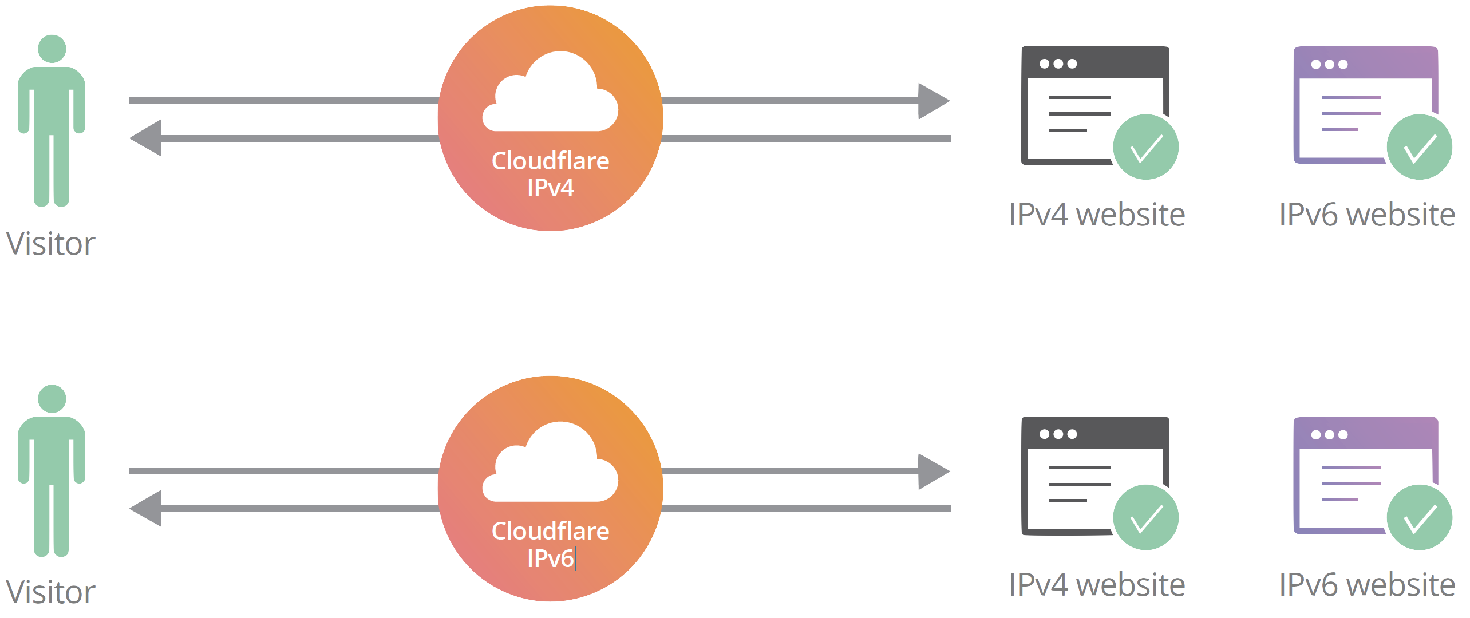
At Cloudflare, IPv6 is always on!
// The Punchline!

Slide 6
// Introduction to Cloudflare
Cloudflare provides performance, security, reliability, and insights to anything connected to the Internet.

Slide 7
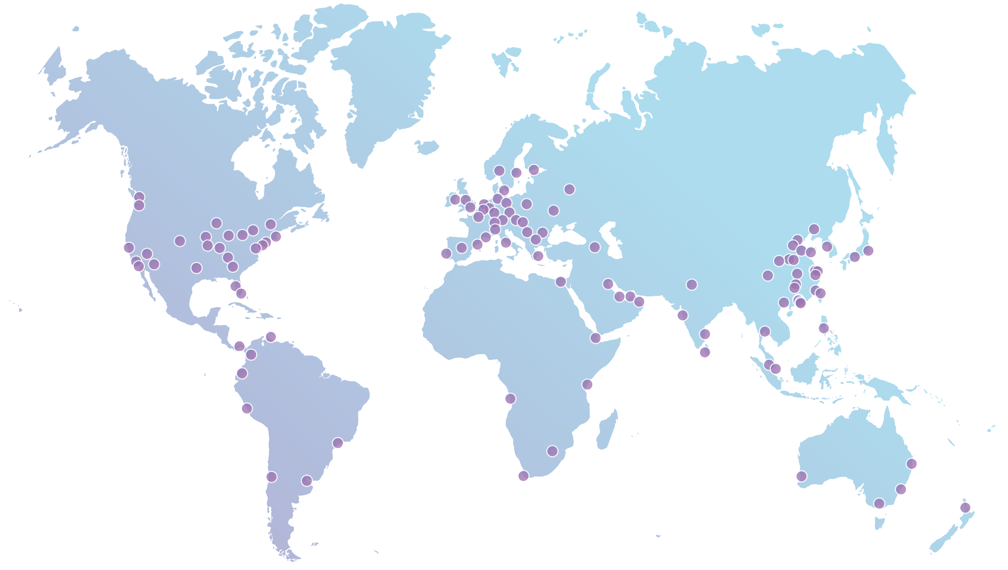
AS13335 / Cloudflare’s Global Anycast Network
5M
10%
HTTP requests/second
Internet requests everyday
Data centers globally
Speeds up each request by
115
2x
EVERYTHING IPv4/IPv6
1.2M
DNS requests/second

Slide 8
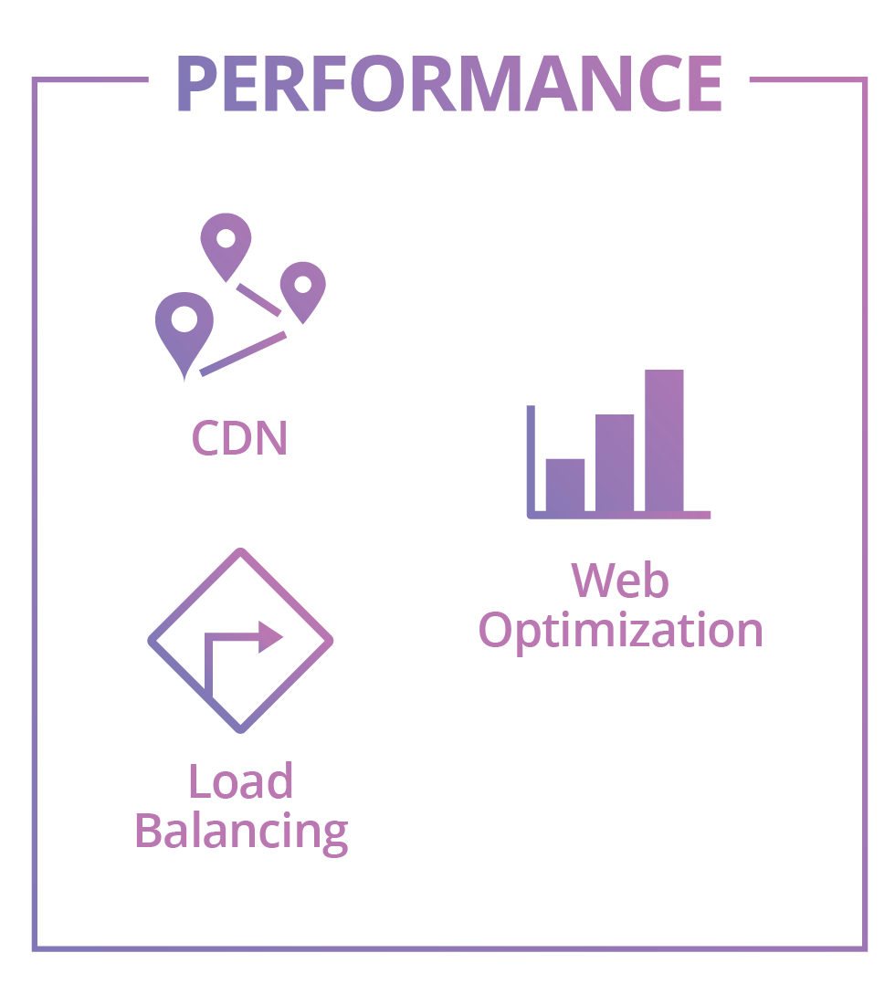
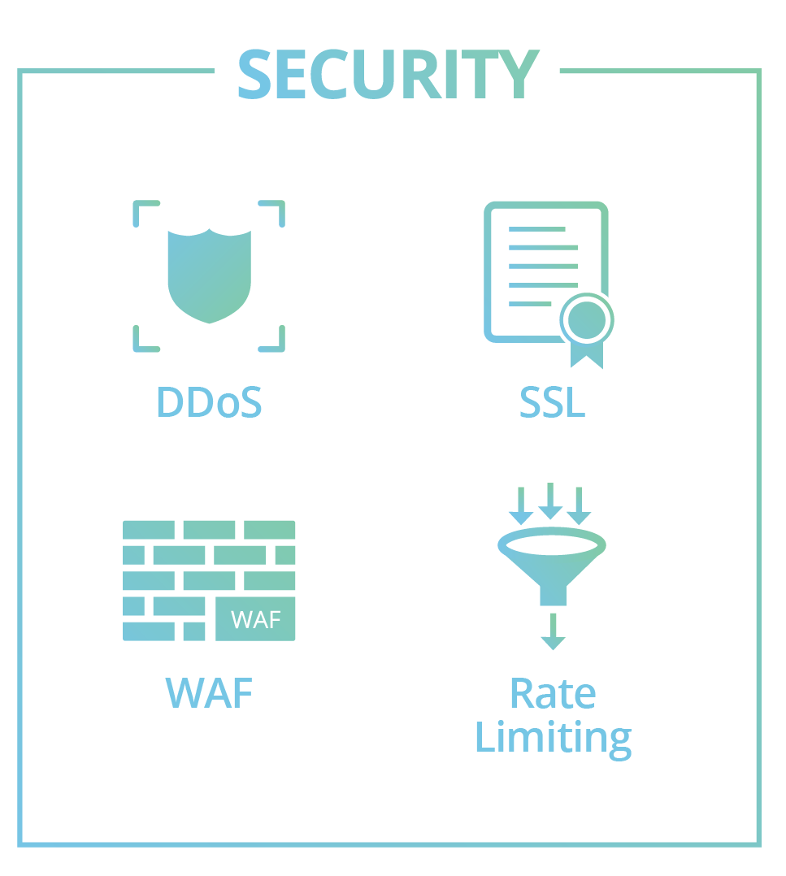
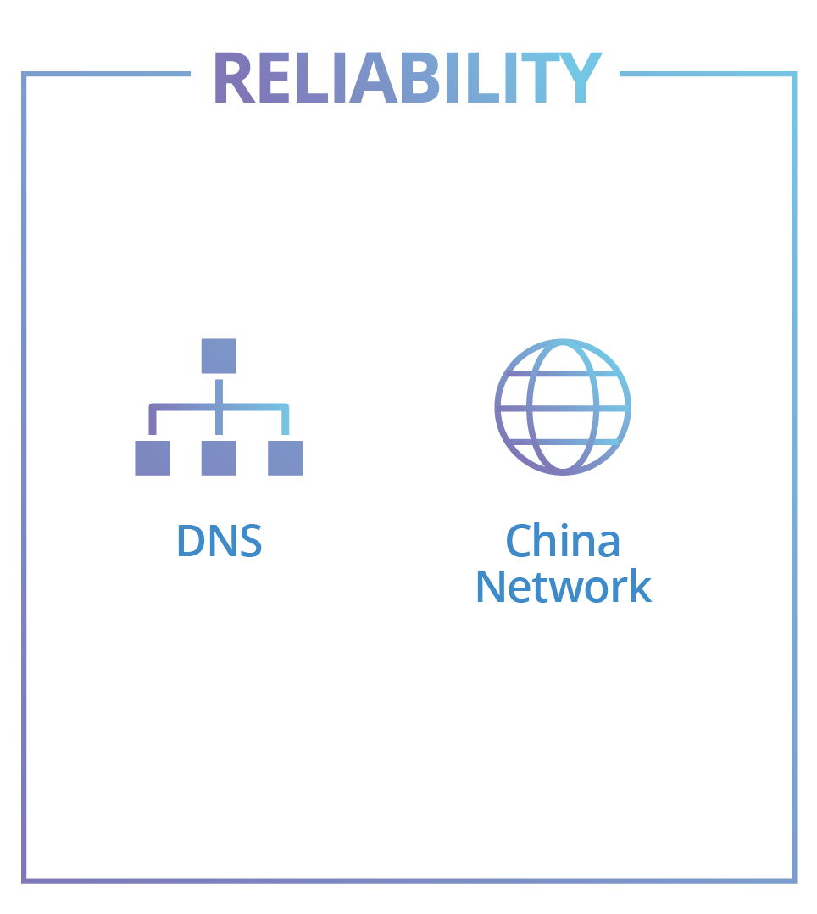
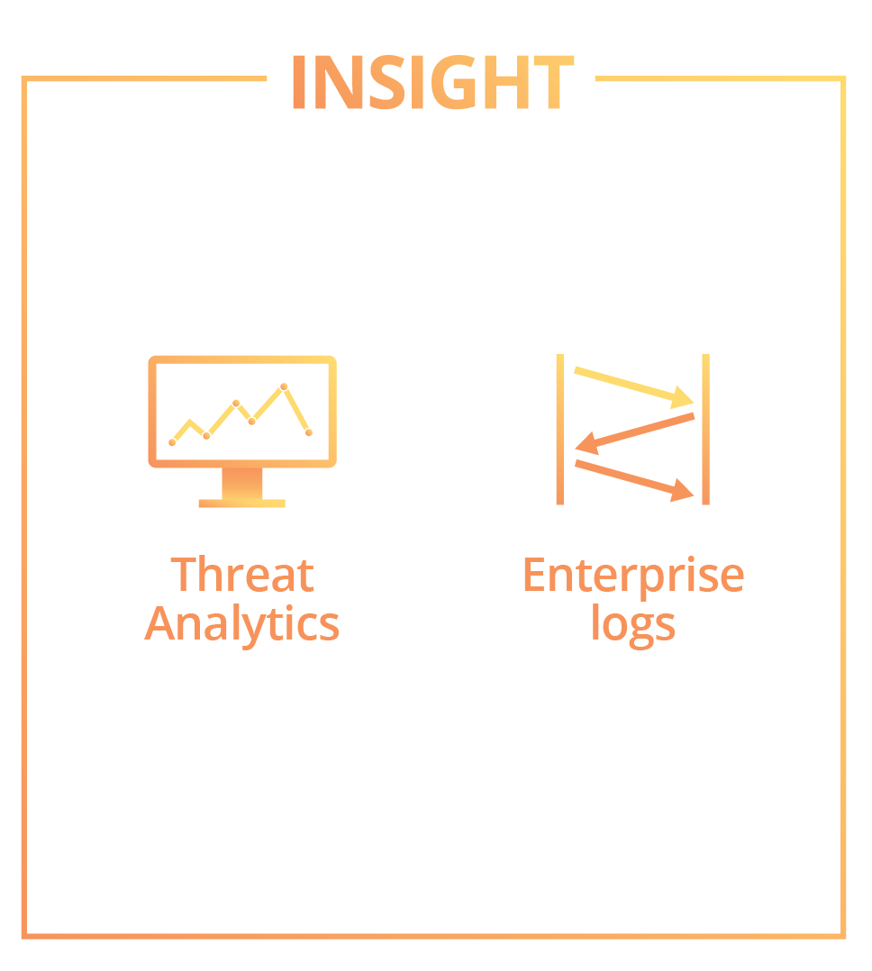
Cloudflare’s benefits
// Cloudflare Introduction

Slide 9
Performance
// Cloudflare Introduction
CDN Moving content physically closer to visitors with our CDN.
SSL Modern SSL isn’t just for security—it can actually improve the performance of your website.
Website Optimization Cloudflare lets you automatically enable the latest in web technologies.
Dedicated SSL Certificates With a few clicks within the Cloudflare dashboard, you can easily and quickly issue new certificates, securely generate private keys and more.
DNS Cloudflare is one of the fastest managed DNS providers in the world.
Load Balancing Cloudflare Load Balancing provides load balancing, geo-steering, monitoring and failover for your Internet facing infrastructure enhancing service availability.

Slide 10
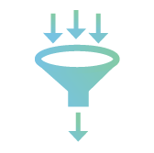
Security
// Cloudflare Introduction
DDoS Protection Our enterprise-class DDoS protection network has 20 times more capacity than the largest DDoS attack ever recorded.
Secure Registrar Registering your domain through Cloudflare is the most secure way to protect your trademark from domain hijacking.
WAF Our web application firewall benefits from the collective intelligence of our entire network.
Dedicated SSL Certificates With a few clicks within the CloudFlare dashboard, you can easily and quickly issue new certificates, securely generate private keys and more.
SSL HTTPS is a must-have for modern websites, and Cloudflare makes it easy to configure SSL.
Rate Limiting Rate Limiting gives you granular controls to detect bad traffic, customized rulesets to ensure that your legitimate visitors are not impacted, and insights to improve your security posture as attacks evolve.

Slide 11
Reliability
// Cloudflare Introduction
DNS Cloudflare’s DNS service is powered by the same 102 data center network that powers our DDoS and CDN services. This not only improves DNS resolution times, but also makes DNS-related attacks and outages a thing of the past.
China Network Cloudflare’s China service optimizes Internet connections in mainland China, dramatically improving the viewing experience for visitors in China.
Predictable Bandwidth Costs We believe that you should never be surprised by your monthly bill. Our flat-rate pricing structure makes your CDN and DDoS bandwidth expenses predictable.

Slide 12
Insight
// Cloudflare Introduction
Enterprise Logs For enterprise customers, we can provide consolidated logs from around the world. These are very rich, containing detailed information about every request and response.
Threat Analytics When we identify requests that are threats, we log them and block them. That means we not only protect your site, but also provide insight into the malicious activity we’re seeing.
Rate Limiting Rate Limiting gives you granular controls to detect bad traffic, customized rulesets to ensure that your legitimate visitors are not impacted, and insights to improve your security posture as attacks evolve.

Slide 13
A few of our Technology customers

Slide 14
// Now Down to the Technical Parts …
Cloudflare has a solid history of giving back to the community, both in open-source software, IETF protocol development, network services, etc.

Slide 15
The Technical Part
// Technical Part
Backstory behind the IPv6 switch at Cloudflare
Some useful IPv6 data
A serious discussion about DNS in a v6 world
Why we removed the switch!

Slide 16
IPv6 @ Cloudflare is so 2606:4700::5ca1:ab1e:6810:4737

Slide 17
Cloudflare can be a “bridge” to IPv6

Slide 18
Cloudflare can be a “bridge” to IPv6

Slide 19
Cloudflare can be a “bridge” to IPv6

Slide 20
Cloudflare can be a “bridge” to IPv6

Slide 21
// Flipping the Switch!
Five plus years of having the IPv6 switch in our system.
The default was “off”.

Slide 22
Flipping the Switch on Every Domain/Zone
Nearly five million zones on Cloudflare (at this point)
If the user had never touched the IPv6 switch; then flip it on!
Slow start; then running faster (around ~100,000 zones per day)
for zone in all_zones:
if zone.ipv6.value == False:
if zone.ipv6.date == None:
zone.ipv6.value = True
zone.ipv6.date = Now()
sleep()

Slide 23
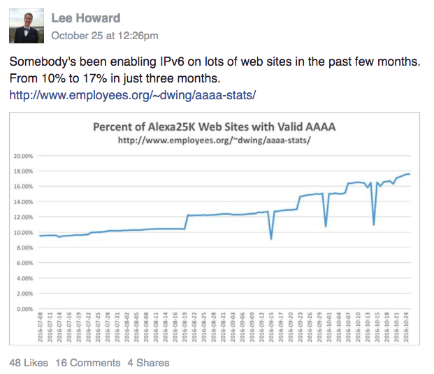
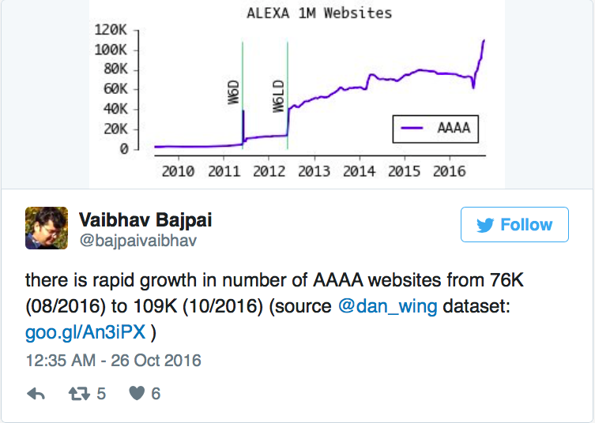
People (Some You May Know) Noticed!

Slide 24
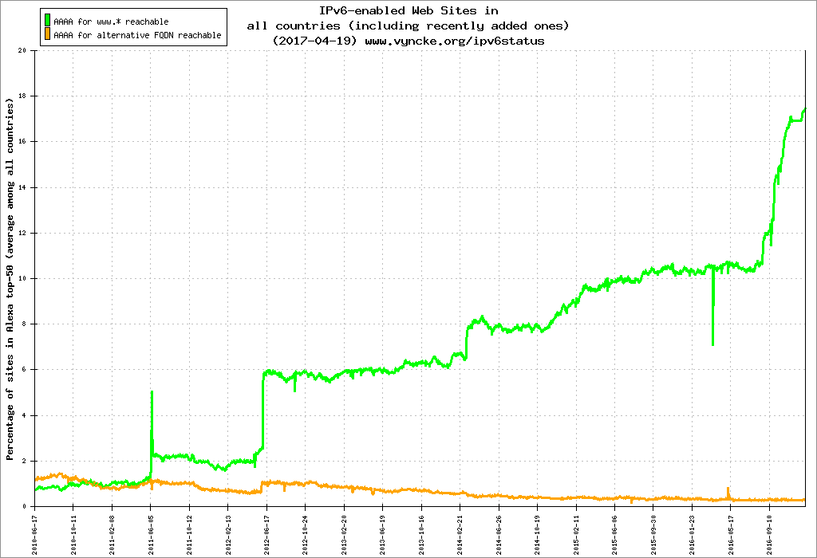
Eric Vyncke’s graph is it’s full glory!
Cloudflare
hits 98.01%
Cloudflare
starts process
https://www.vyncke.org/ipv6status/
https://blog.cloudflare.com/98-percent-ipv6/

Slide 25
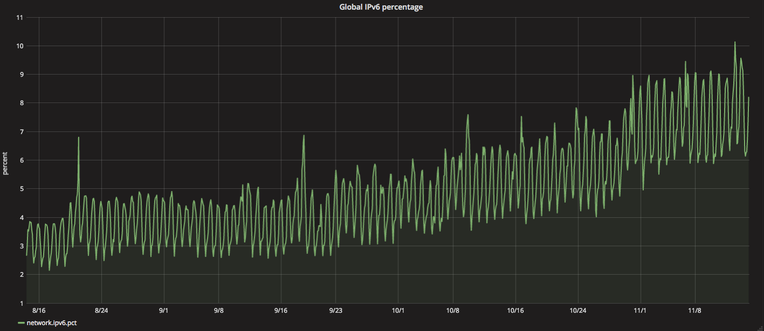

Slide 26
// Removing the Switch

Slide 27
The Disable IPv6 Switch Goes Away!
Before:
After:
… IPv6 is on by default (and unchangeable) for the vast majority** of accounts!
** high paying accounts still get the switch

Slide 28
// Who and What is Driving IPv6?

Slide 29
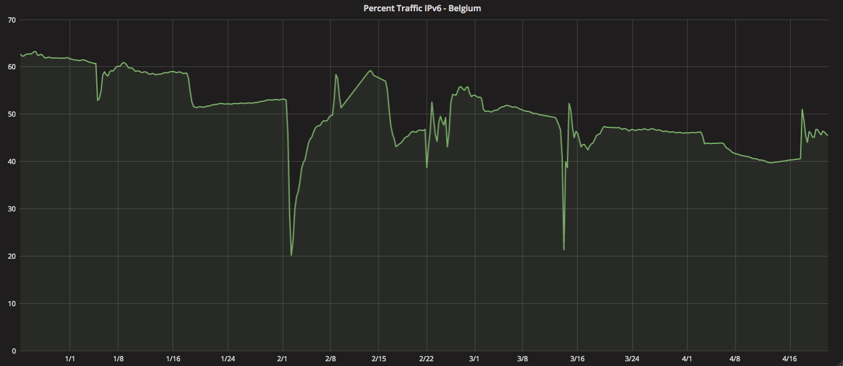
Top IPv6 Countries – Belgium
Country | Percent Bytes IPv6
Ireland | 46.40%
Belgium | 46.08%
Greece | 24.20%
Mauritius | 20.80%
India | 19.16%
Luxembourg | 17.46%
Estonia | 16.22%
Japan | 14.71%
Switzerland | 13.90%
Ecuador | 12.38%

Slide 30
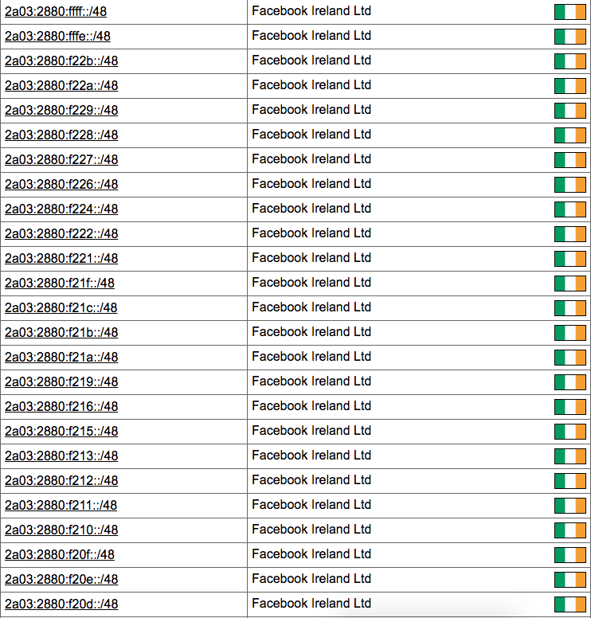
Top IPv6 Countries – Ireland (kinda)
Country | Percent Bytes IPv6
Ireland | 46.40%
Belgium | 46.08%
Greece | 24.20%
Mauritius | 20.80%
India | 19.16%
Luxembourg | 17.46%
Estonia | 16.22%
Japan | 14.71%
Switzerland | 13.90%
Ecuador | 12.38%
81% of Facebook (crawl) traffic from Cloudflare is IPv6-based

Slide 31
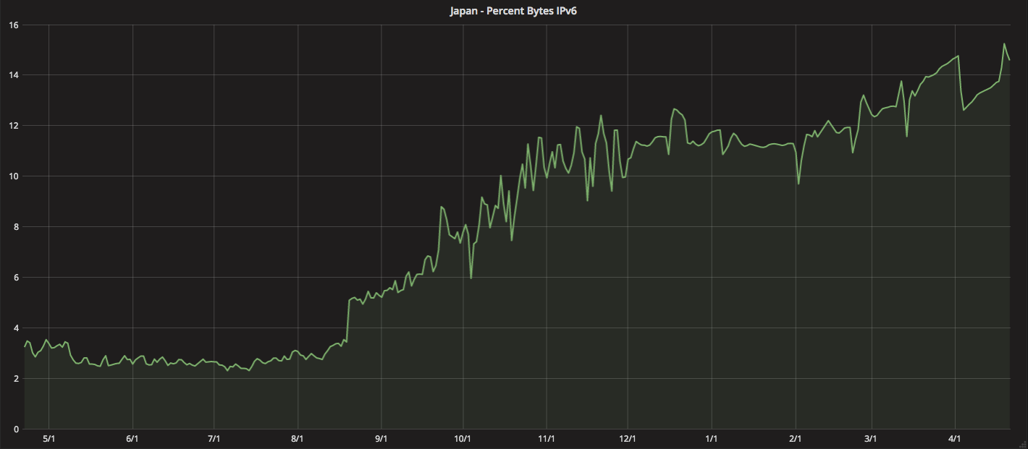
Top IPv6 Countries – Japan
Country | Percent Bytes IPv6
Ireland | 46.40%
Belgium | 46.08%
Greece | 24.20%
Mauritius | 20.80%
India | 19.16%
Luxembourg | 17.46%
Estonia | 16.22%
Japan | 14.71%
Switzerland | 13.90%
Ecuador | 12.38%

Slide 32
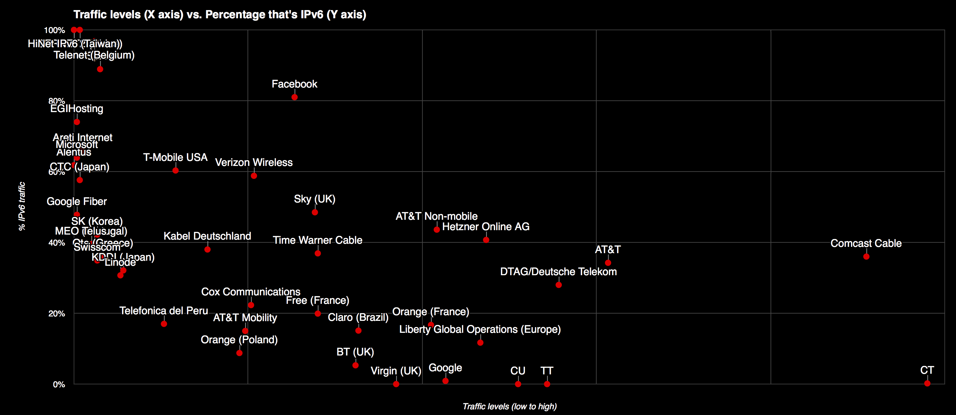
Percentage of IPv6 vs. Bandwidth per Network

Slide 33
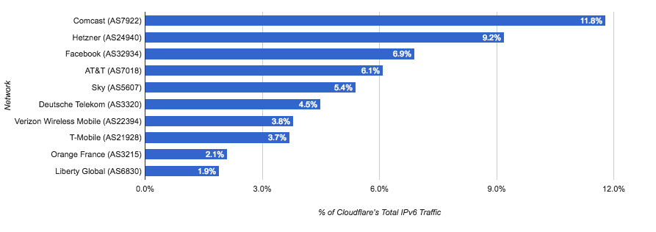
Top 10 IPv6 (~55% of Cloudlfare IPv6 Traffic)

Slide 34
1 | 100.0% | Orange Polska
2 | 100.0% | China Next Generation Internet CERNET2
3 | 100.0% | HiNet IPv6 (Taiwan)
4 | 96.8% | Telenet (Belgium)
5 | 91.5% | Time Warner Cable
6 | 88.9% | Sprint
7 | 81.0% | Facebook
8 | 74.0% | EGIHosting
9 | 65.9% | Areti Internet
10 | 63.9% | Microsoft
11 | 61.8% | Alentus
12 | 60.3% | T-Mobile USA
13 | 58.8% | Verizon Wireless
14 | 57.6% | Chubu Telecommunications Company
15 | 48.5% | Sky (UK)
16 | 47.8% | Google Fiber
17 | 44.6% | AIS Fibre (Thailand)
18 | 43.6% | AT&T
19 | 43.3% | Hughes Network Systems
20 | 43.2% | wilhelm.tel GmbH Norderstedt

Slide 35
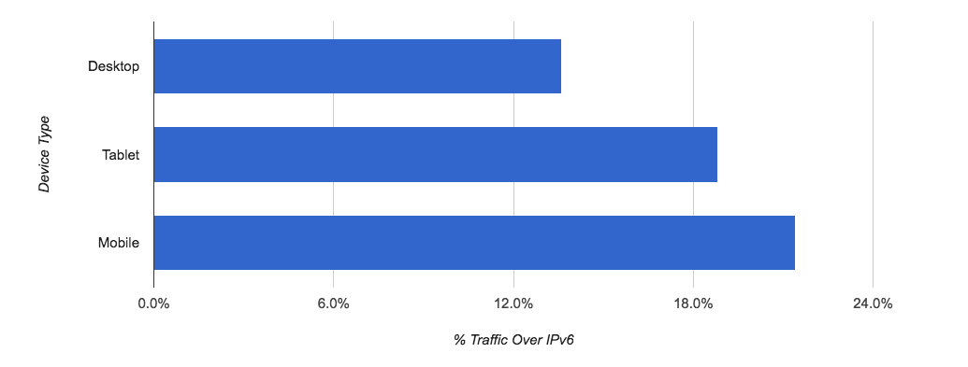
IPv6 by Device Type

Slide 36
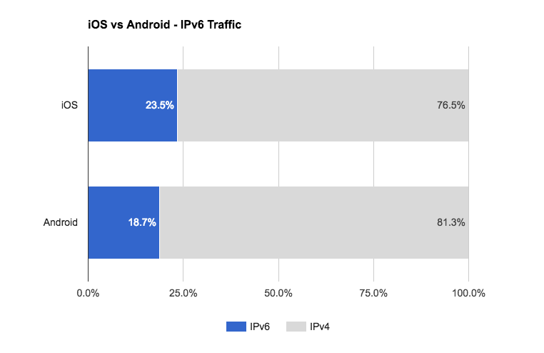
iOS vs Android

Slide 37
Windows and IPv6

Slide 38
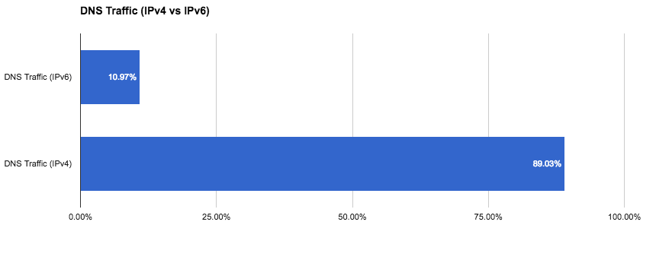
DNS traffic and floods (IPv4 vs IPv6)

Slide 39
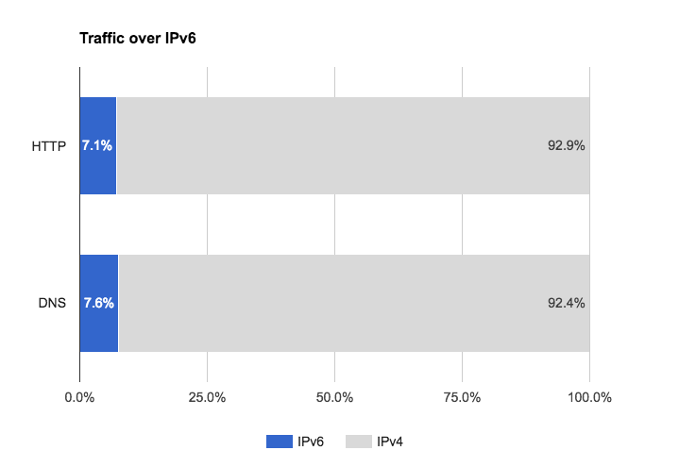
IPv6 and DNS

Slide 40
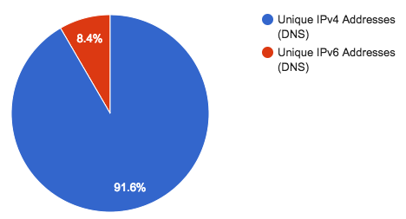
More v6 addresses != more v6 uniques in DNS

Slide 41
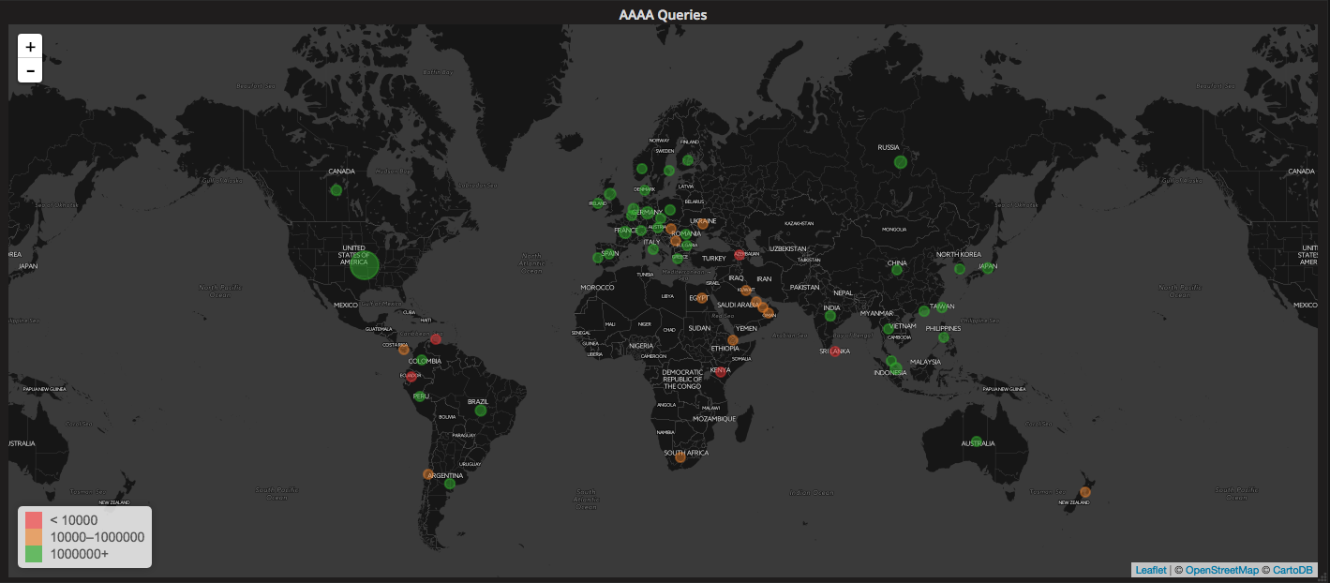
IPv6 Global Map (AAAA queries)

Slide 42
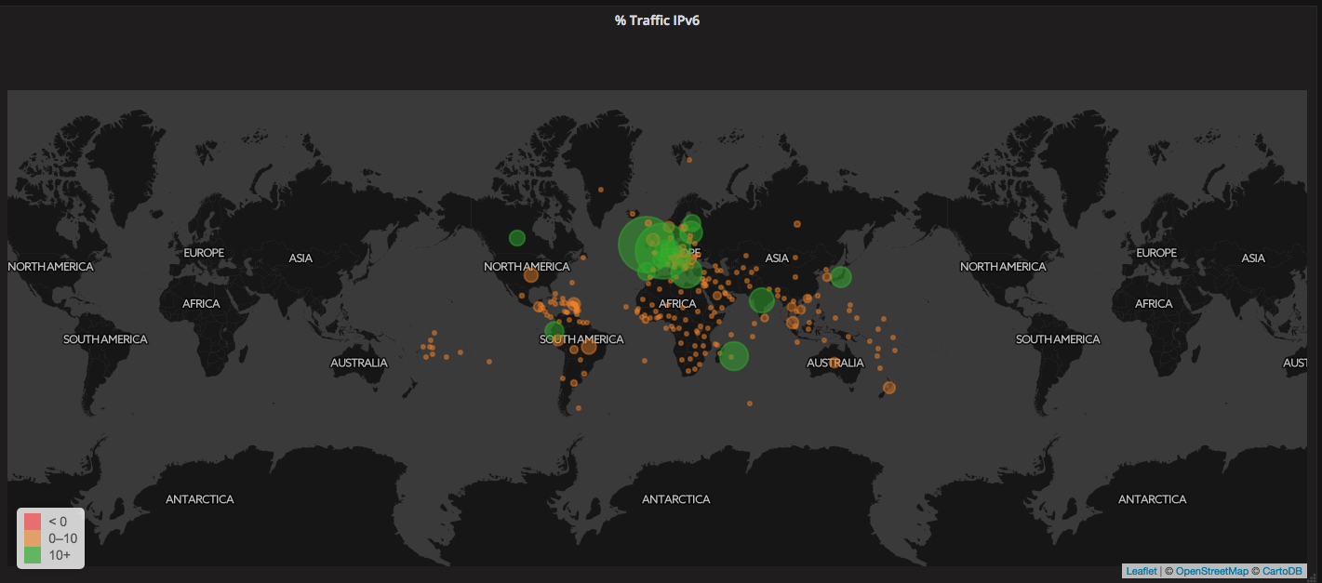
IPv6 Global Map (% Traffic IPv6)

Slide 43
// Deprecated IPv6 DNS – Remember A6?

Slide 44
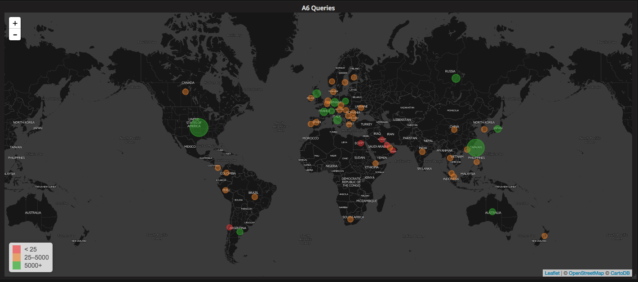
IPv6 Global Map (A6 Queries – Not a Typo)

Slide 45
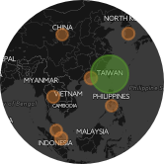
Who’s Sending A6?
1 | AS3462 | Data Communication Business Group
2 | AS6181 | CAR-PART.COM
3 | AS24683 | Orenburg State University
4 | AS1221 | Telstra Internet
5 | AS2510 | FUJITSU LIMITED
6 | AS24945 | Telecommunication Company Vinteleport Ltd.
7 | AS7127 | Southern California Edison
8 | AS701 | MCI Communications Services, Inc. d/b/a Verizon Business
9 | AS12962 | First Investment Bank AD
10 | AS1659 | Ministry of Education Computer Center

Slide 46
// What’s next for IPv6? Fix DNS!

Slide 47
A & AAAA Records - How Silly is this in 2017?
Separate A & AAAA records
In a happy-eyeball environment we still need two DNS queries (before any TCP connection can be instigated)
Query for A record
Query for AAAA record

Slide 48
AAAA For Free (When Doing an A Query)!
Cloudflare proposed solution:
A + AAAA in new meta-query
Resolver asks for A or AAAA
If positive answer, the resolver then checks AAAA + A meta-query
Resolver remembers whether authoritative server supports meta-query for future queries
Resolver adds both A and AAAA to cache

Slide 49
Working code (an IETF must!)
$ dig cloudflare.com @ns1.cloudflare.com -t TYPE65535 +short
198.41.215.162
198.41.214.162
2400:cb00:2048:1::c629:d6a2
2400:cb00:2048:1::c629:d7a2
$
This is live - try it with any domain on Cloudflare.
$ dig taylorswift.com @ashley.ns.cloudflare.com -t TYPE65535 +short
104.16.193.61
104.16.194.61
104.16.191.61
104.16.192.61
104.16.195.61
2400:cb00:2048:1::6810:c33d
2400:cb00:2048:1::6810:c13d
2400:cb00:2048:1::6810:bf3d
2400:cb00:2048:1::6810:c23d
2400:cb00:2048:1::6810:c03d
$

Slide 50
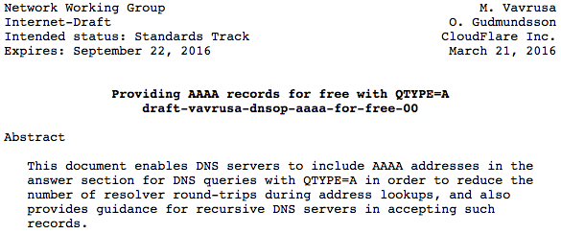
IETF draft – pick one, any one (maybe ours?)
https://tools.ietf.org/html/draft-vavrusa-dnsop-aaaa-for-free-00
https://tools.ietf.org/html/draft-yao-dnsop-accompanying-questions-02
https://tools.ietf.org/html/draft-bellis-dnsext-multi-qtypes-03
https://tools.ietf.org/html/draft-vavrusa-dnsop-aaaa-for-free-00

Slide 51
Thank you!
martin@cloudflare.com @mahtin / @cloudflare

